Slide 1
Chapter 9
Patterns of Inheritance

Slide 2
Genetics and Heredity
Heredity유전 is the transmission of traits from one generation to the next.
Genetics유전학 is the scientific study of heredity.
Gregor Mendel worked in the 1860s and argued that
parents pass on to their offspring discrete genes (which he termed “heritable factors”),
genes are responsible for inherited traits, and
genes retain their individual identities generation after generation, no matter how they are mixed up or temporarily masked.
Notes:
2
Student Misconceptions and Concerns
1. Students might think that dominant alleles are naturally (a) more common, (b) more likely to be inherited, and (c) better for an organism. The text notes that this is not necessarily true. However, this might need to be emphasized further in lecture.
2. Students using Punnett squares need to be reminded that the calculations are expected statistical probabilities and not absolutes. Just as we would expect that any six playing cards dealt might be half black and half red, we frequently find that this is not true. This might be a good time to show how larger sample sizes increase the likelihood that sampling reflects expected ratios.
3. The authors note that Mendel’s work was published in 1866, seven years after Darwin published On the Origin of Species. Consider challenging your students to consider whether Mendel’s findings were supportive of Darwin’s ideas. Some scientists have noted that Darwin often discussed the evolution of traits by matters of degree. Yet Mendel’s selection of pea plant traits typically showed complete dominance. Mendel’s pea traits did not show the possibility for such gradual inheritance.
Teaching Tips
1. Medical technology raises many ethical issues. Consider asking your students this practical question: How much routine fetal testing do we want our insurance companies to cover and at what cost for insurance? Ultrasound, for example, is routinely performed on pregnant women as a normal part of prenatal care. What other tests should be standard? Who should decide? Who should pay?
2. This early material introduces many definitions that are vital to understanding the later discussions in this chapter. Therefore, students need to be encouraged to master these definitions immediately. This may be a good time for a short quiz to encourage their progress.
3. Consider this analogy for dominance of a trait in the heterozygous condition, which may help struggling students. Two people are trying to make a decision about where to eat tonight. One person wants to eat at a restaurant, the other wants to eat a meal at home. If this “heterozygous” couple eats at home, the dominant allele “wins.”
4. Many students benefit from a little quick practice with a Punnett square. Have them try these crosses for practice: (a) PP × pp and (b) Pp × pp.
5. Understanding dihybrid crosses may be the most difficult concept in this chapter. Consider spending additional time to make these ideas very clear. As the text indicates, dihybrid crosses are essentially two monohybrid crosses.
6. Consider challenging your students to explain why a testcross of two black Labs of unknown genotypes might not reveal the genotype of each dog. Explanation: If both dogs are heterozygous, or homozygous, the results would reveal the genotypes because the offspring would either be three black and one chocolate or all black. But if one black Lab was homozygous and the other heterozygous, we could not determine which Lab has which genotype.
7. The 2/3 fraction noted in the discussion of carriers of a recessive disorder (and in Figure 9.14) often catches students off guard, as they may be expecting odds of 1/4, 1/2, or 3/4. However, we eliminate the dd (deaf) possibility, as it would not be a carrier. So, the odds are based out of the remaining three genotypes Dd, dD, and DD.
8. Genetic tests are now available to inform a person whether he or she has the Huntington’s allele. The test is especially important to the children of a parent with Huntington’s disease. Consider asking your class (a) what are the odds of developing Huntington’s disease if a parent has this disease (50%) and (b) whether or not they would want this genetic test. The Huntington Disease Society website (www.hdsa.org) offers many additional details. It is a good starting point for those who want to explore this disease in more detail.
Active Lecture Tips
1. Many students have trouble with the basic statistics that are necessary for many of these calculations. Give your students some practice. Consider having them work in pairs, each with a pair of dice (for large class sizes, this can be done in laboratories). Let them calculate the odds of rolling three sixes in a row and other possibilities.
2. As a simple test of comprehension, ask students to work in pairs to explain why lethal alleles are not eliminated from a population. Several possibilities exist: (a) The lethal allele might be recessive, persisting in the population due to the survival of carriers, or (b) the lethal allele might be dominant, but is not expressed until after the age of reproduction.
3. See the Media Review: “Learn.Genetics” Genetic Science Learning Center from the University of Utah on the Instructor Exchange. Visit the Instructor Exchange in the MasteringBiology instructor resource area for a description of this activity.
4. See the activity Interactive Celebrity Parents Genetic Inheritance Game on the Instructor Exchange. Visit the Instructor Exchange in the MasteringBiology instructor resource area for a description of this activity.
5. See the activity Personal Genomics: Would You Give Your DNA Away? on the Instructor Exchange. Visit the Instructor Exchange in the MasteringBiology instructor resource area for a description of this activity.

Slide 3
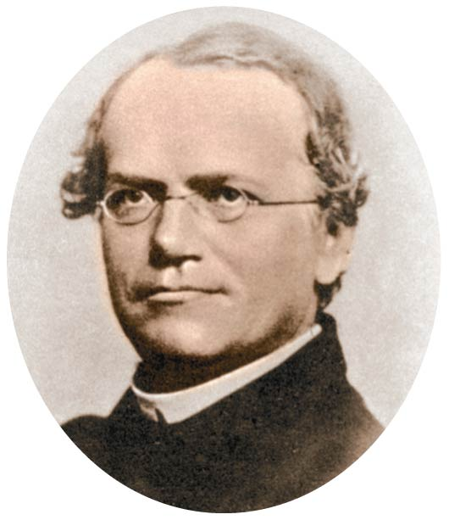
In an Abbey Garden
Mendel probably chose to study garden peas because they
were easy to grow and
came in many readily distinguishable varieties.
A character is a heritable feature that varies among individuals.
A trait특성 is a variant of a character.
Each of the characters Mendel
studied occurred in two distinct traits.
Notes:
3
Student Misconceptions and Concerns
1. Students might think that dominant alleles are naturally (a) more common, (b) more likely to be inherited, and (c) better for an organism. The text notes that this is not necessarily true. However, this might need to be emphasized further in lecture.
2. Students using Punnett squares need to be reminded that the calculations are expected statistical probabilities and not absolutes. Just as we would expect that any six playing cards dealt might be half black and half red, we frequently find that this is not true. This might be a good time to show how larger sample sizes increase the likelihood that sampling reflects expected ratios.
3. The authors note that Mendel’s work was published in 1866, seven years after Darwin published On the Origin of Species. Consider challenging your students to consider whether Mendel’s findings were supportive of Darwin’s ideas. Some scientists have noted that Darwin often discussed the evolution of traits by matters of degree. Yet Mendel’s selection of pea plant traits typically showed complete dominance. Mendel’s pea traits did not show the possibility for such gradual inheritance.
Teaching Tips
1. Medical technology raises many ethical issues. Consider asking your students this practical question: How much routine fetal testing do we want our insurance companies to cover and at what cost for insurance? Ultrasound, for example, is routinely performed on pregnant women as a normal part of prenatal care. What other tests should be standard? Who should decide? Who should pay?
2. This early material introduces many definitions that are vital to understanding the later discussions in this chapter. Therefore, students need to be encouraged to master these definitions immediately. This may be a good time for a short quiz to encourage their progress.
3. Consider this analogy for dominance of a trait in the heterozygous condition, which may help struggling students. Two people are trying to make a decision about where to eat tonight. One person wants to eat at a restaurant, the other wants to eat a meal at home. If this “heterozygous” couple eats at home, the dominant allele “wins.”
4. Many students benefit from a little quick practice with a Punnett square. Have them try these crosses for practice: (a) PP × pp and (b) Pp × pp.
5. Understanding dihybrid crosses may be the most difficult concept in this chapter. Consider spending additional time to make these ideas very clear. As the text indicates, dihybrid crosses are essentially two monohybrid crosses.
6. Consider challenging your students to explain why a testcross of two black Labs of unknown genotypes might not reveal the genotype of each dog. Explanation: If both dogs are heterozygous, or homozygous, the results would reveal the genotypes because the offspring would either be three black and one chocolate or all black. But if one black Lab was homozygous and the other heterozygous, we could not determine which Lab has which genotype.
7. The 2/3 fraction noted in the discussion of carriers of a recessive disorder (and in Figure 9.14) often catches students off guard, as they may be expecting odds of 1/4, 1/2, or 3/4. However, we eliminate the dd (deaf) possibility, as it would not be a carrier. So, the odds are based out of the remaining three genotypes Dd, dD, and DD.
8. Genetic tests are now available to inform a person whether he or she has the Huntington’s allele. The test is especially important to the children of a parent with Huntington’s disease. Consider asking your class (a) what are the odds of developing Huntington’s disease if a parent has this disease (50%) and (b) whether or not they would want this genetic test. The Huntington Disease Society website (www.hdsa.org) offers many additional details. It is a good starting point for those who want to explore this disease in more detail.
Active Lecture Tips
1. Many students have trouble with the basic statistics that are necessary for many of these calculations. Give your students some practice. Consider having them work in pairs, each with a pair of dice (for large class sizes, this can be done in laboratories). Let them calculate the odds of rolling three sixes in a row and other possibilities.
2. As a simple test of comprehension, ask students to work in pairs to explain why lethal alleles are not eliminated from a population. Several possibilities exist: (a) The lethal allele might be recessive, persisting in the population due to the survival of carriers, or (b) the lethal allele might be dominant, but is not expressed until after the age of reproduction.
3. See the Media Review: “Learn.Genetics” Genetic Science Learning Center from the University of Utah on the Instructor Exchange. Visit the Instructor Exchange in the MasteringBiology instructor resource area for a description of this activity.
4. See the activity Interactive Celebrity Parents Genetic Inheritance Game on the Instructor Exchange. Visit the Instructor Exchange in the MasteringBiology instructor resource area for a description of this activity.
5. See the activity Personal Genomics: Would You Give Your DNA Away? on the Instructor Exchange. Visit the Instructor Exchange in the MasteringBiology instructor resource area for a description of this activity.

Slide 4
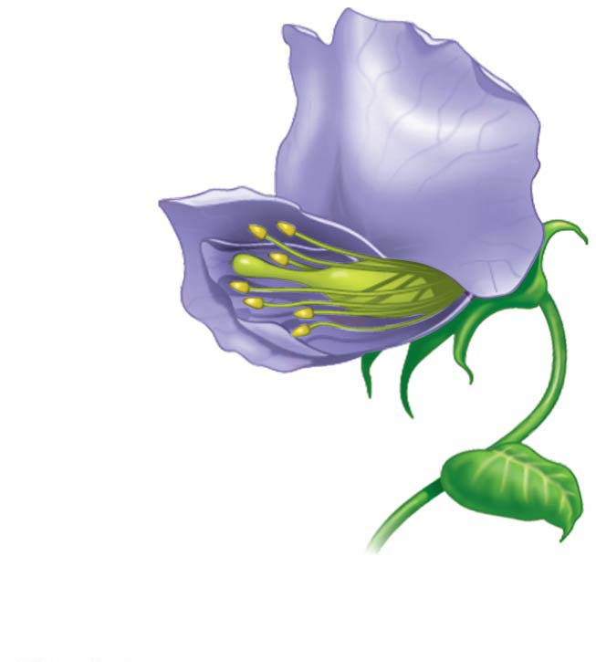
Figure 9.2
Perhaps the most important advantage of pea plants as an experimental model was that Mendel could strictly control their reproduction.
꽃잎Petal
Stamen수술
(makes sperm-
producing
pollen)
Carpel암술
(produces eggs)
Notes:
Figure 9.2 The structure of a pea flower

Slide 5
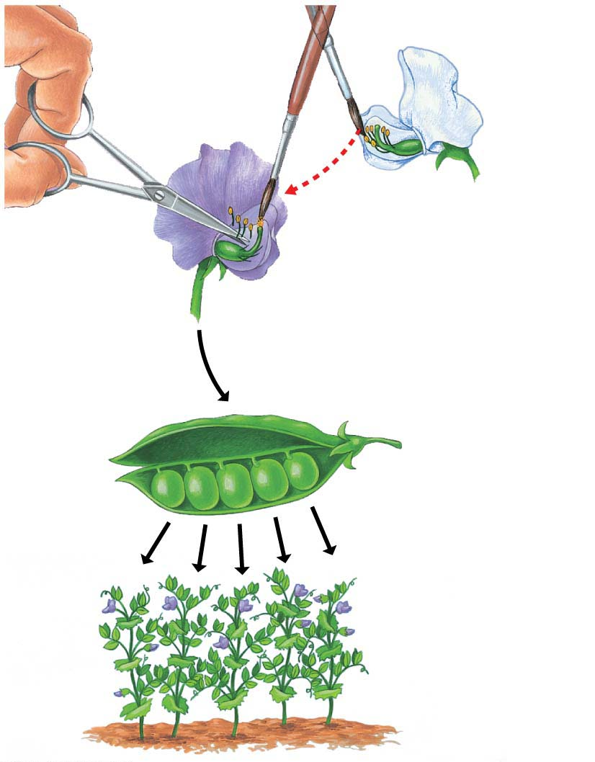
Figure 9.3-s3
Removed
stamens
from purple
flower.
Stamens
Parents
(P)
Transferred pollen from
stamens of white flower
to carpel of purple flower.
Carpel
Pollinated carpel
matured into pod.
Planted seeds
from pod.
Offspring
(F₁)
Notes:
Figure 9.3-s3 Mendel’s technique for cross-fertilizing pea plants (step 3)

Slide 6
Mendel
created purebred순계 varieties of plants and
crossed two different purebred varieties.
Hybrids잡종 are the offspring of two different purebred varieties.
The cross-fertilization itself is referred to as a genetic cross교배.
The parental plants are the P generation부모세대.
Their hybrid offspring are the F₁ generation자손1세대.
A cross of the F₁ plants forms the F₂ generation.
Notes:
6
Student Misconceptions and Concerns
1. Students might think that dominant alleles are naturally (a) more common, (b) more likely to be inherited, and (c) better for an organism. The text notes that this is not necessarily true. However, this might need to be emphasized further in lecture.
2. Students using Punnett squares need to be reminded that the calculations are expected statistical probabilities and not absolutes. Just as we would expect that any six playing cards dealt might be half black and half red, we frequently find that this is not true. This might be a good time to show how larger sample sizes increase the likelihood that sampling reflects expected ratios.
3. The authors note that Mendel’s work was published in 1866, seven years after Darwin published On the Origin of Species. Consider challenging your students to consider whether Mendel’s findings were supportive of Darwin’s ideas. Some scientists have noted that Darwin often discussed the evolution of traits by matters of degree. Yet Mendel’s selection of pea plant traits typically showed complete dominance. Mendel’s pea traits did not show the possibility for such gradual inheritance.
Teaching Tips
1. Medical technology raises many ethical issues. Consider asking your students this practical question: How much routine fetal testing do we want our insurance companies to cover and at what cost for insurance? Ultrasound, for example, is routinely performed on pregnant women as a normal part of prenatal care. What other tests should be standard? Who should decide? Who should pay?
2. This early material introduces many definitions that are vital to understanding the later discussions in this chapter. Therefore, students need to be encouraged to master these definitions immediately. This may be a good time for a short quiz to encourage their progress.
3. Consider this analogy for dominance of a trait in the heterozygous condition, which may help struggling students. Two people are trying to make a decision about where to eat tonight. One person wants to eat at a restaurant, the other wants to eat a meal at home. If this “heterozygous” couple eats at home, the dominant allele “wins.”
4. Many students benefit from a little quick practice with a Punnett square. Have them try these crosses for practice: (a) PP × pp and (b) Pp × pp.
5. Understanding dihybrid crosses may be the most difficult concept in this chapter. Consider spending additional time to make these ideas very clear. As the text indicates, dihybrid crosses are essentially two monohybrid crosses.
6. Consider challenging your students to explain why a testcross of two black Labs of unknown genotypes might not reveal the genotype of each dog. Explanation: If both dogs are heterozygous, or homozygous, the results would reveal the genotypes because the offspring would either be three black and one chocolate or all black. But if one black Lab was homozygous and the other heterozygous, we could not determine which Lab has which genotype.
7. The 2/3 fraction noted in the discussion of carriers of a recessive disorder (and in Figure 9.14) often catches students off guard, as they may be expecting odds of 1/4, 1/2, or 3/4. However, we eliminate the dd (deaf) possibility, as it would not be a carrier. So, the odds are based out of the remaining three genotypes Dd, dD, and DD.
8. Genetic tests are now available to inform a person whether he or she has the Huntington’s allele. The test is especially important to the children of a parent with Huntington’s disease. Consider asking your class (a) what are the odds of developing Huntington’s disease if a parent has this disease (50%) and (b) whether or not they would want this genetic test. The Huntington Disease Society website (www.hdsa.org) offers many additional details. It is a good starting point for those who want to explore this disease in more detail.
Active Lecture Tips
1. Many students have trouble with the basic statistics that are necessary for many of these calculations. Give your students some practice. Consider having them work in pairs, each with a pair of dice (for large class sizes, this can be done in laboratories). Let them calculate the odds of rolling three sixes in a row and other possibilities.
2. As a simple test of comprehension, ask students to work in pairs to explain why lethal alleles are not eliminated from a population. Several possibilities exist: (a) The lethal allele might be recessive, persisting in the population due to the survival of carriers, or (b) the lethal allele might be dominant, but is not expressed until after the age of reproduction.
3. See the Media Review: “Learn.Genetics” Genetic Science Learning Center from the University of Utah on the Instructor Exchange. Visit the Instructor Exchange in the MasteringBiology instructor resource area for a description of this activity.
4. See the activity Interactive Celebrity Parents Genetic Inheritance Game on the Instructor Exchange. Visit the Instructor Exchange in the MasteringBiology instructor resource area for a description of this activity.
5. See the activity Personal Genomics: Would You Give Your DNA Away? on the Instructor Exchange. Visit the Instructor Exchange in the MasteringBiology instructor resource area for a description of this activity.

Slide 7
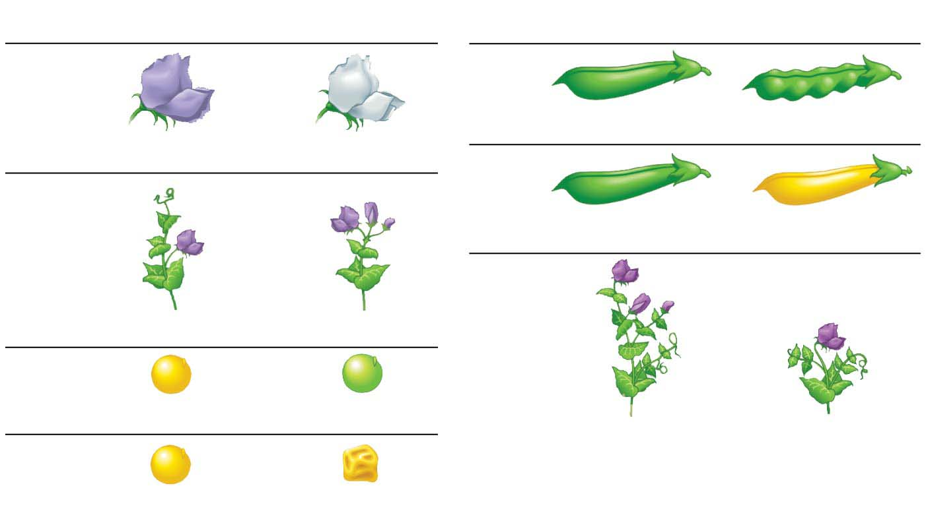
Figure 9.4
Dominant우성
Recessive열성
Dominant
Recessive
Flower
color
Pod
shape
Inflated
Constricted
Purple
White
Pod
color
Flower
position
Green
Yellow
Stem
length
Axial
Terminal
Seed
color
Yellow
Green
Tall
Dwarf
Seed
shape
Round
Wrinkled
Notes:
Figure 9.4 The seven characters of pea plants studied by Mendel

Slide 8
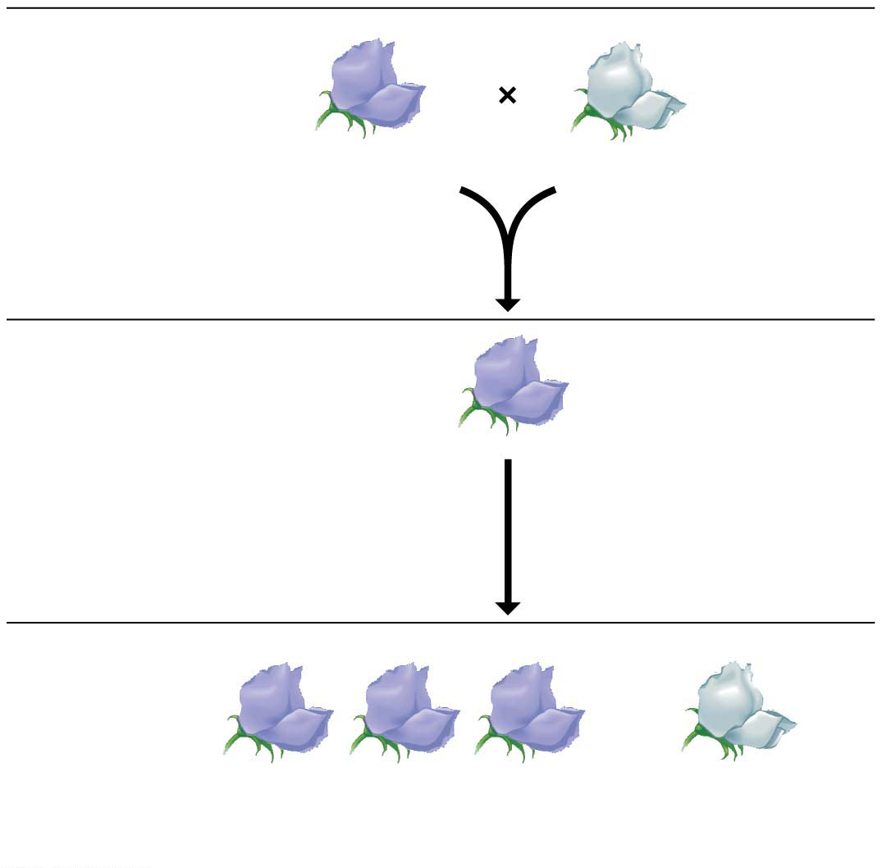
Figure 9.5-s3
P Generation
(purebred
parents)
Purple
flowers
White
flowers
F₁ Generation
All plants have
purple flowers
Monohybrid Crosses
단성잡종교배
Fertilization
among F₁ plants
(F₁ ⋅ F₁)
F₂ Generation
3
4
1
4
of plants
have purple flowers
of plants
have white flowers
Notes:
Figure 9.5-s3 Mendel’s cross tracking one character (flower color) (step 3)

Slide 9
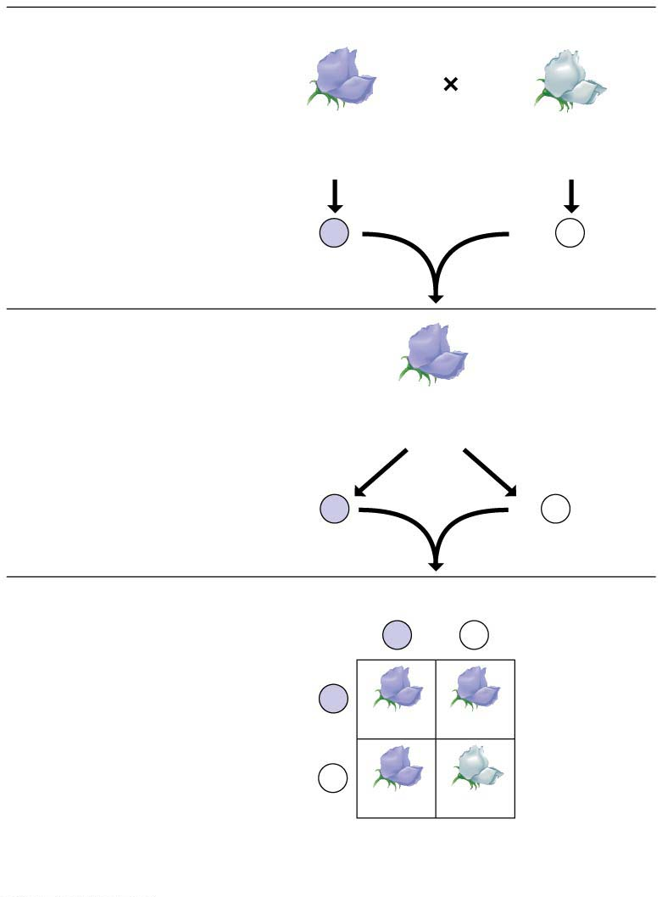
Figure 9.6
P Generation
Genetic makeup (alleles)
Purple flowers
White flowers
Alleles carried
by parents
PP
pp
Gametes
All
P
All
p
F₁ Generation
(hybrids)
Purple flowers
Alleles
segregate
Gametes
All
Pp
1
2
P
1
2
p
F₂ Generation
(hybrids)
Sperm from F₁ plant
P
p
P
Eggs from
F₁ plant
PP
Pp
Punnett square
p
Pp
pp
Phenotypic표현형 ratio
3 purple:1 white
Genotypic유전자형 ratio
1 PP:2 Pp:1 pp
Notes:
Figure 9.6 The law of segregation

Slide 10
From these results and others, Mendel developed four hypotheses:
There are alternative versions of genes that account for variations in inherited characters.
The alternative versions of genes are called alleles대립인자.
For each inherited character, an organism inherits two alleles, one from each parent.
An organism that has two identical alleles for a gene is said to be homozygous동형 for that gene.
An organism that has two different alleles for a gene is said to be heterozygous이형 for that gene.
If the two alleles of an inherited pair differ, then one determines the organism’s appearance and is called the dominant allele우성대립인자, and the other has no noticeable effect on the organism’s appearance and is called the recessive allele열성대립인자.
Geneticists use uppercase italic letters (such as P) to represent dominant alleles and lowercase italic letters (such as p) to represent recessive alleles.
A sperm or egg carries only one allele for each inherited character because the two alleles for a character segregate (separate) from each other during the production of gametes.
This statement is called the law of segregation분리의 법칙.
When sperm and egg unite at fertilization, each contributes its alleles, restoring the paired condition in the offspring.
Notes:
10
Student Misconceptions and Concerns
1. Students might think that dominant alleles are naturally (a) more common, (b) more likely to be inherited, and (c) better for an organism. The text notes that this is not necessarily true. However, this might need to be emphasized further in lecture.
2. Students using Punnett squares need to be reminded that the calculations are expected statistical probabilities and not absolutes. Just as we would expect that any six playing cards dealt might be half black and half red, we frequently find that this is not true. This might be a good time to show how larger sample sizes increase the likelihood that sampling reflects expected ratios.
3. The authors note that Mendel’s work was published in 1866, seven years after Darwin published On the Origin of Species. Consider challenging your students to consider whether Mendel’s findings were supportive of Darwin’s ideas. Some scientists have noted that Darwin often discussed the evolution of traits by matters of degree. Yet Mendel’s selection of pea plant traits typically showed complete dominance. Mendel’s pea traits did not show the possibility for such gradual inheritance.
Teaching Tips
1. Medical technology raises many ethical issues. Consider asking your students this practical question: How much routine fetal testing do we want our insurance companies to cover and at what cost for insurance? Ultrasound, for example, is routinely performed on pregnant women as a normal part of prenatal care. What other tests should be standard? Who should decide? Who should pay?
2. This early material introduces many definitions that are vital to understanding the later discussions in this chapter. Therefore, students need to be encouraged to master these definitions immediately. This may be a good time for a short quiz to encourage their progress.
3. Consider this analogy for dominance of a trait in the heterozygous condition, which may help struggling students. Two people are trying to make a decision about where to eat tonight. One person wants to eat at a restaurant, the other wants to eat a meal at home. If this “heterozygous” couple eats at home, the dominant allele “wins.”
4. Many students benefit from a little quick practice with a Punnett square. Have them try these crosses for practice: (a) PP × pp and (b) Pp × pp.
5. Understanding dihybrid crosses may be the most difficult concept in this chapter. Consider spending additional time to make these ideas very clear. As the text indicates, dihybrid crosses are essentially two monohybrid crosses.
6. Consider challenging your students to explain why a testcross of two black Labs of unknown genotypes might not reveal the genotype of each dog. Explanation: If both dogs are heterozygous, or homozygous, the results would reveal the genotypes because the offspring would either be three black and one chocolate or all black. But if one black Lab was homozygous and the other heterozygous, we could not determine which Lab has which genotype.
7. The 2/3 fraction noted in the discussion of carriers of a recessive disorder (and in Figure 9.14) often catches students off guard, as they may be expecting odds of 1/4, 1/2, or 3/4. However, we eliminate the dd (deaf) possibility, as it would not be a carrier. So, the odds are based out of the remaining three genotypes Dd, dD, and DD.
8. Genetic tests are now available to inform a person whether he or she has the Huntington’s allele. The test is especially important to the children of a parent with Huntington’s disease. Consider asking your class (a) what are the odds of developing Huntington’s disease if a parent has this disease (50%) and (b) whether or not they would want this genetic test. The Huntington Disease Society website (www.hdsa.org) offers many additional details. It is a good starting point for those who want to explore this disease in more detail.
Active Lecture Tips
1. Many students have trouble with the basic statistics that are necessary for many of these calculations. Give your students some practice. Consider having them work in pairs, each with a pair of dice (for large class sizes, this can be done in laboratories). Let them calculate the odds of rolling three sixes in a row and other possibilities.
2. As a simple test of comprehension, ask students to work in pairs to explain why lethal alleles are not eliminated from a population. Several possibilities exist: (a) The lethal allele might be recessive, persisting in the population due to the survival of carriers, or (b) the lethal allele might be dominant, but is not expressed until after the age of reproduction.
3. See the Media Review: “Learn.Genetics” Genetic Science Learning Center from the University of Utah on the Instructor Exchange. Visit the Instructor Exchange in the MasteringBiology instructor resource area for a description of this activity.
4. See the activity Interactive Celebrity Parents Genetic Inheritance Game on the Instructor Exchange. Visit the Instructor Exchange in the MasteringBiology instructor resource area for a description of this activity.
5. See the activity Personal Genomics: Would You Give Your DNA Away? on the Instructor Exchange. Visit the Instructor Exchange in the MasteringBiology instructor resource area for a description of this activity.

Slide 11
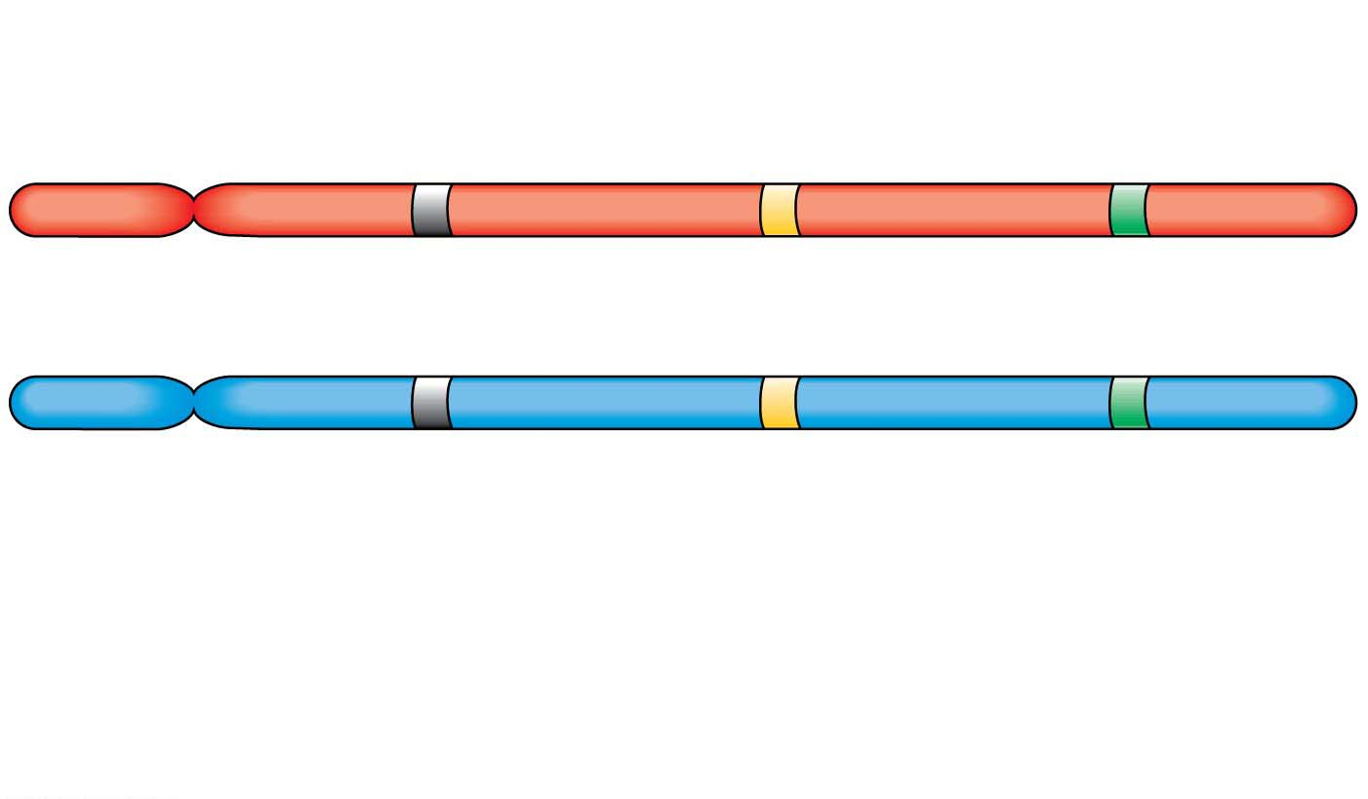
Figure 9.7
A gene locus좌위 is a specific location of
a gene along a chromosome
Gene loci
Dominant
allele
Homologous
Chromosomes
상동염색체
P
a
B
P
a
b
Recessive
allele
유전자형Genotype:
aa
Bb
PP
Homozygous
for the
dominant allele
Homozygous
for the
recessive allele
Heterozygous
with one dominant
and one recessive
allele
Notes:
Figure 9.7 The relationship between alleles and homologous chromosomes

Slide 12
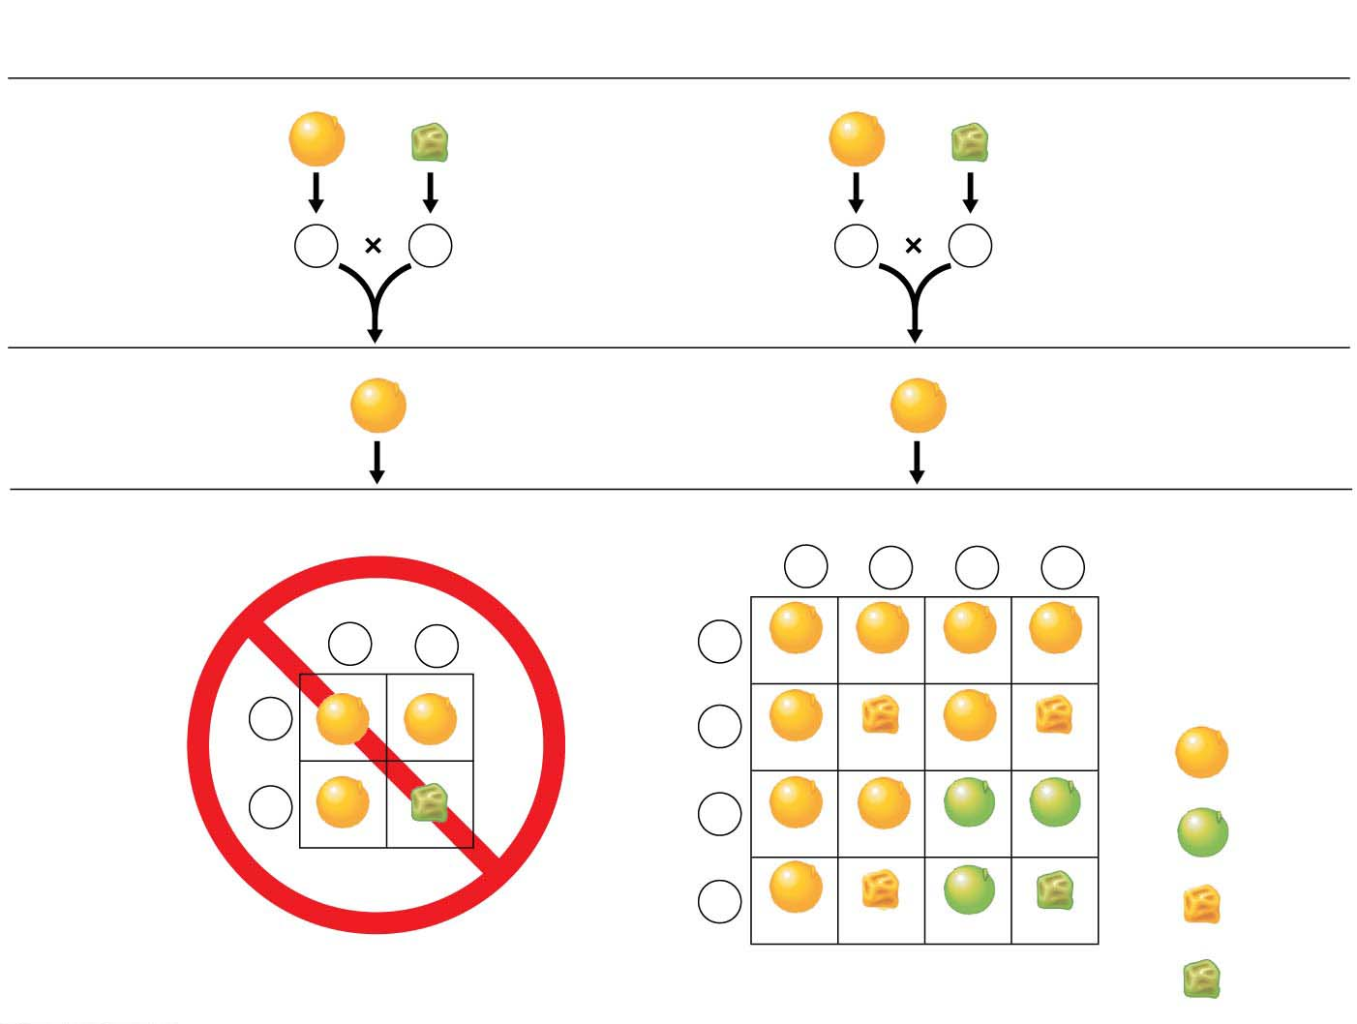
Figure 9.8
(a) Hypothesis:
Dependent assortment
(b) Hypothesis:
Independent assortment
P Generation
RRYY
rryy
RRYY
rryy
Gametes
RY
ry
Gametes
RY
ry
dihybrid cross
F₁ Generation
RrYy
RrYy
the inheritance of one character has no effect on the inheritance of another
F₂ Generation
Sperm
1
4
RY
1
4
rY
1
4
Ry
1
4
ry
Sperm
1
2
RY
1
2
ry
1
4
RY
RRYY
RrYY
RRYy
RrYy
1
2
RY
1
4
rY
Eggs
RrYY
RrYy
9
16
Yellow
round
Eggs
rrYY
rrYy
1
2
ry
1
4
Ry
3
16
Green
round
RRYy
RrYy
RRyy
Rryy
1
4
ry
3
16
Yellow
wrinkled
RrYy
rrYy
Rryy
rryy
Predicted results
(not actually seen)
Actual results
(support hypothesis)
1
16
Green
wrinkled
Notes:
Figure 9.8 Testing alternative hypotheses for gene assortment in a dihybrid cross

Slide 13
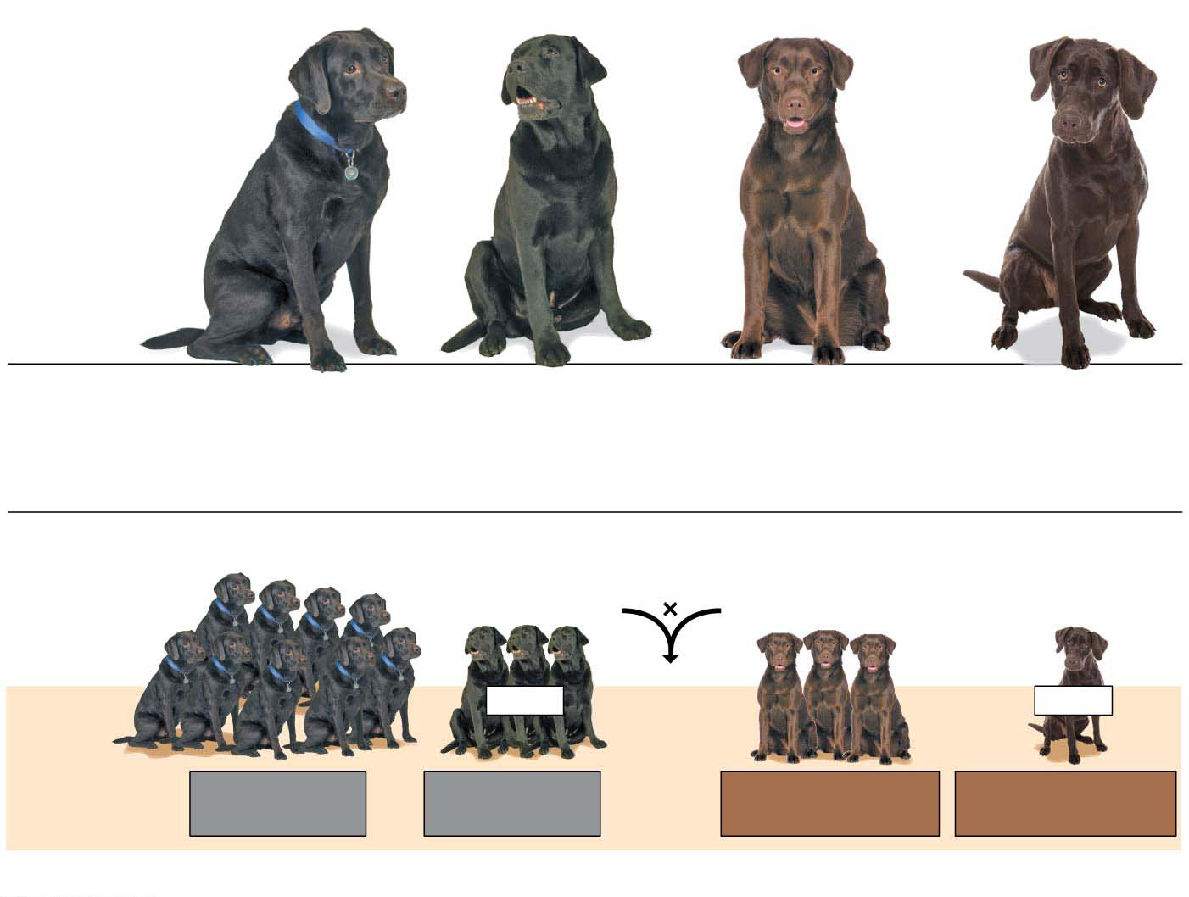
Figure 9.9
Blind dog
Blind dog
Phenotypes
Black coat,
normal vision
Black coat,
blind (PRA)
Chocolate coat,
normal vision
Chocolate coat,
blind (PRA)
Genotypes
B_N_
B_nn
bbN_
bbnn
(a) Possible phenotypes of Labrador retrievers
Mating of double heterozygotes
(black coat, normal vision)
BbNn
BbNn
Blind
Blind
Phenotypic
ratio of
offspring
9 black coat,
normal vision
3 black coat,
blind (PRA)
3 chocolate coat,
normal vision
1 chocolate coat,
blind (PRA)
(b) A Labrador dihybrid cross
Notes:
Figure 9.9 Independent assortment of genes in Labrador retrievers

Slide 14
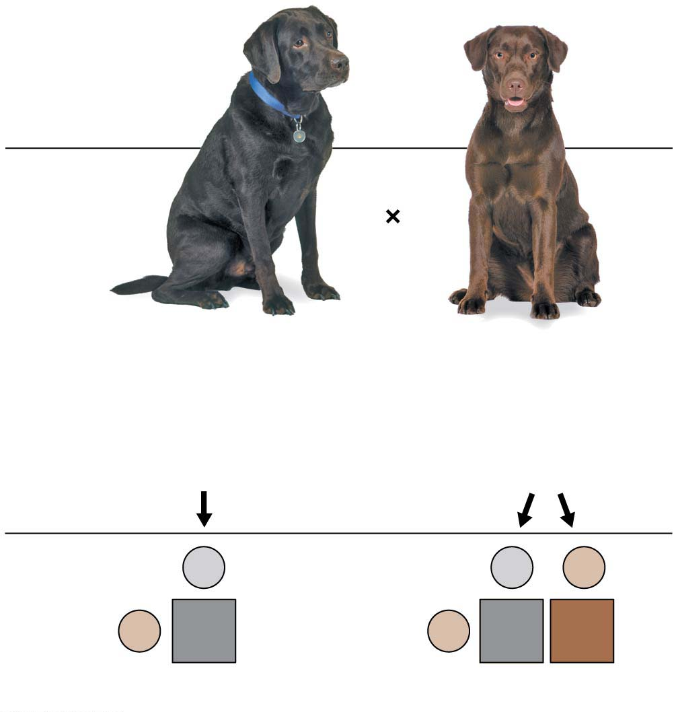
Figure 9.10
A testcross검정교배 is a mating between an individual of dominant phenotype (but unknown genotype) and a homozygous recessive individual.
Genotypes
B ?
bb
Two possible genotypes for the black dog:
BB
or
Bb
B
Gametes
B
b
Bb
b
b
Bb
bb
Offspring
All black
1 black : 1 chocolate
Notes:
Figure 9.10 A Labrador retriever testcross

Slide 15
Family Pedigrees집단계통
Mendel’s principles apply to the inheritance of many human traits.
Figure 9.12 illustrates alternative forms of three human characters that are each thought to be determined by simple dominant-recessive inheritance of one gene.
How can human genetics be studied?
Geneticists
analyze the results of matings that have already occurred and
assemble this information into a family tree, called a pedigree족보.
Figure 9.13 shows a pedigree tracing the incidence of free versus attached earlobes.
Mendel’s laws enable us to deduce the genotypes for most of the people in the pedigree.
Notes:
15
Student Misconceptions and Concerns
1. Students might think that dominant alleles are naturally (a) more common, (b) more likely to be inherited, and (c) better for an organism. The text notes that this is not necessarily true. However, this might need to be emphasized further in lecture.
2. Students using Punnett squares need to be reminded that the calculations are expected statistical probabilities and not absolutes. Just as we would expect that any six playing cards dealt might be half black and half red, we frequently find that this is not true. This might be a good time to show how larger sample sizes increase the likelihood that sampling reflects expected ratios.
3. The authors note that Mendel’s work was published in 1866, seven years after Darwin published On the Origin of Species. Consider challenging your students to consider whether Mendel’s findings were supportive of Darwin’s ideas. Some scientists have noted that Darwin often discussed the evolution of traits by matters of degree. Yet Mendel’s selection of pea plant traits typically showed complete dominance. Mendel’s pea traits did not show the possibility for such gradual inheritance.
Teaching Tips
1. Medical technology raises many ethical issues. Consider asking your students this practical question: How much routine fetal testing do we want our insurance companies to cover and at what cost for insurance? Ultrasound, for example, is routinely performed on pregnant women as a normal part of prenatal care. What other tests should be standard? Who should decide? Who should pay?
2. This early material introduces many definitions that are vital to understanding the later discussions in this chapter. Therefore, students need to be encouraged to master these definitions immediately. This may be a good time for a short quiz to encourage their progress.
3. Consider this analogy for dominance of a trait in the heterozygous condition, which may help struggling students. Two people are trying to make a decision about where to eat tonight. One person wants to eat at a restaurant, the other wants to eat a meal at home. If this “heterozygous” couple eats at home, the dominant allele “wins.”
4. Many students benefit from a little quick practice with a Punnett square. Have them try these crosses for practice: (a) PP × pp and (b) Pp × pp.
5. Understanding dihybrid crosses may be the most difficult concept in this chapter. Consider spending additional time to make these ideas very clear. As the text indicates, dihybrid crosses are essentially two monohybrid crosses.
6. Consider challenging your students to explain why a testcross of two black Labs of unknown genotypes might not reveal the genotype of each dog. Explanation: If both dogs are heterozygous, or homozygous, the results would reveal the genotypes because the offspring would either be three black and one chocolate or all black. But if one black Lab was homozygous and the other heterozygous, we could not determine which Lab has which genotype.
7. The 2/3 fraction noted in the discussion of carriers of a recessive disorder (and in Figure 9.14) often catches students off guard, as they may be expecting odds of 1/4, 1/2, or 3/4. However, we eliminate the dd (deaf) possibility, as it would not be a carrier. So, the odds are based out of the remaining three genotypes Dd, dD, and DD.
8. Genetic tests are now available to inform a person whether he or she has the Huntington’s allele. The test is especially important to the children of a parent with Huntington’s disease. Consider asking your class (a) what are the odds of developing Huntington’s disease if a parent has this disease (50%) and (b) whether or not they would want this genetic test. The Huntington Disease Society website (www.hdsa.org) offers many additional details. It is a good starting point for those who want to explore this disease in more detail.
Active Lecture Tips
1. Many students have trouble with the basic statistics that are necessary for many of these calculations. Give your students some practice. Consider having them work in pairs, each with a pair of dice (for large class sizes, this can be done in laboratories). Let them calculate the odds of rolling three sixes in a row and other possibilities.
2. As a simple test of comprehension, ask students to work in pairs to explain why lethal alleles are not eliminated from a population. Several possibilities exist: (a) The lethal allele might be recessive, persisting in the population due to the survival of carriers, or (b) the lethal allele might be dominant, but is not expressed until after the age of reproduction.
3. See the Media Review: “Learn.Genetics” Genetic Science Learning Center from the University of Utah on the Instructor Exchange. Visit the Instructor Exchange in the MasteringBiology instructor resource area for a description of this activity.
4. See the activity Interactive Celebrity Parents Genetic Inheritance Game on the Instructor Exchange. Visit the Instructor Exchange in the MasteringBiology instructor resource area for a description of this activity.
5. See the activity Personal Genomics: Would You Give Your DNA Away? on the Instructor Exchange. Visit the Instructor Exchange in the MasteringBiology instructor resource area for a description of this activity.

Slide 16
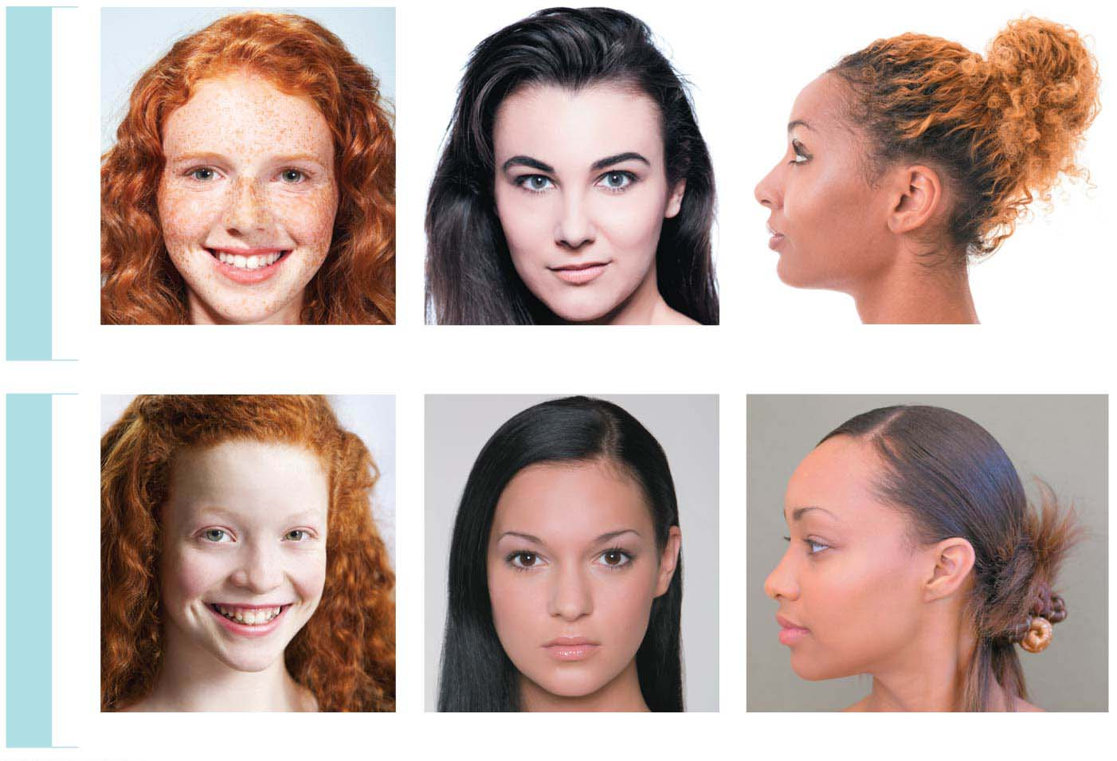
Figure 9.12
DOMINANT TRAITS
Freckles
Widow’s peak
Free earlobe
RECESSIVE TRAITS
No freckles
Straight hairline
Attached earlobe
Notes:
Figure 9.12 Examples of inherited human traits thought to be controlled by a single gene

Slide 17
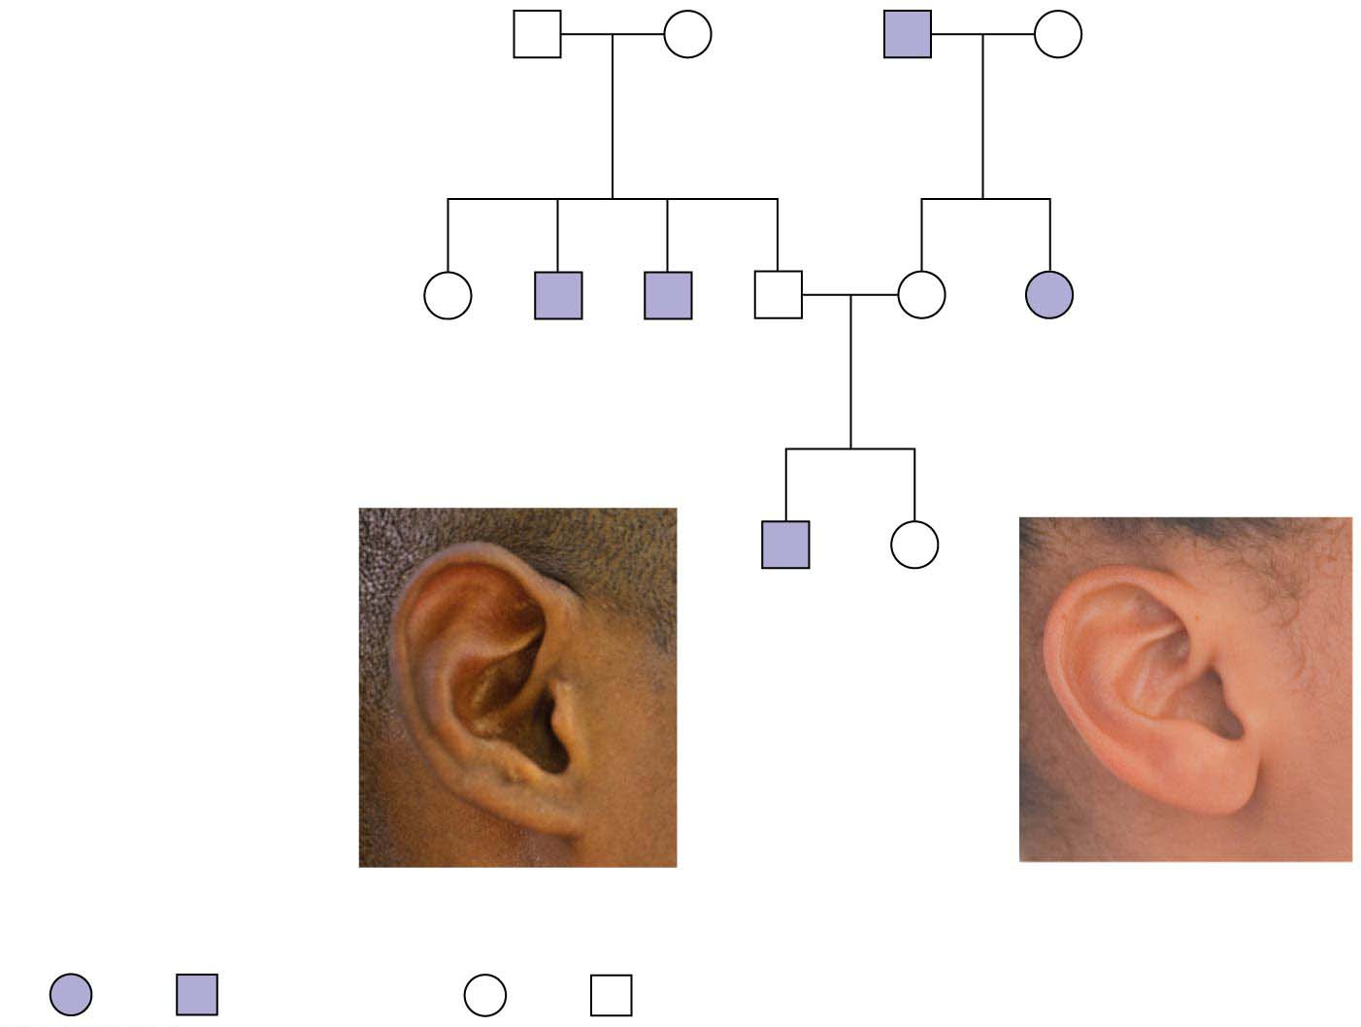
Figure 9.13-1
First generation
(grandparents)
Aaron
Ff
Betty
Ff
Cletus
ff
Debbie
Ff
Second generation
(parents, aunts, and
uncles)
Evelyn
FF
or
Ff
Fred
ff
Gabe
ff
Hal
Ff
Ina
Ff
Julia
ff
Third generation
(brother and
sister)
Kevin
ff
Lisa
FF
or
Ff
Female
Male
Female
Male
Attached
Free
Notes:
Figure 9.13-1 A family pedigree showing inheritance of free versus attached earlobes (part 1: pedigree)

Slide 18
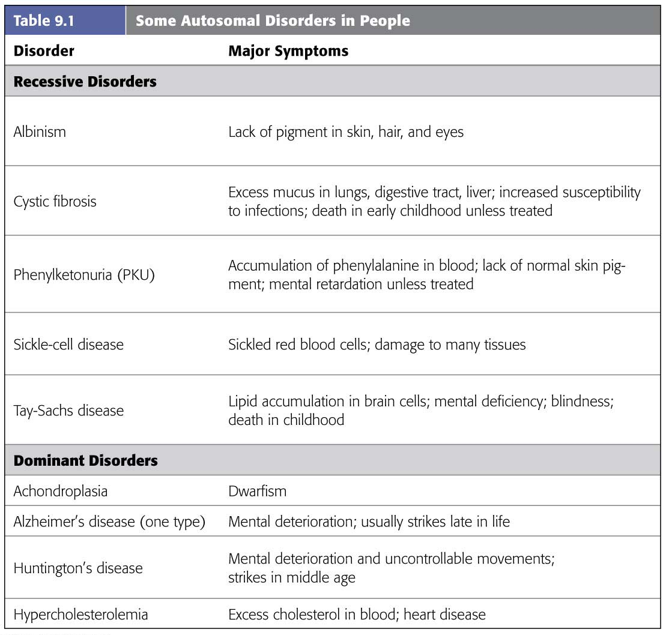
Table 9.1
Human Disorders Controlled by a Single Gene
Notes:
Table 9.1 Some autosomal disorders in people

Slide 19
Most human genetic disorders are recessive.
Individuals who have the recessive allele but appear normal are carriers보인자 of the disorder.
A number of human disorders are caused by dominant alleles.
Achondroplasia연골무형성증 is a form of dwarfism.
The homozygous dominant genotype (AA) causes death of the embryo.
Therefore, only heterozygotes (Aa), individuals with a single copy of the defective allele, have this disorder.
This also means that a person with achondroplasia has a 50% chance of passing the condition on to any children.
Notes:
19
Student Misconceptions and Concerns
1. Students might think that dominant alleles are naturally (a) more common, (b) more likely to be inherited, and (c) better for an organism. The text notes that this is not necessarily true. However, this might need to be emphasized further in lecture.
2. Students using Punnett squares need to be reminded that the calculations are expected statistical probabilities and not absolutes. Just as we would expect that any six playing cards dealt might be half black and half red, we frequently find that this is not true. This might be a good time to show how larger sample sizes increase the likelihood that sampling reflects expected ratios.
3. The authors note that Mendel’s work was published in 1866, seven years after Darwin published On the Origin of Species. Consider challenging your students to consider whether Mendel’s findings were supportive of Darwin’s ideas. Some scientists have noted that Darwin often discussed the evolution of traits by matters of degree. Yet Mendel’s selection of pea plant traits typically showed complete dominance. Mendel’s pea traits did not show the possibility for such gradual inheritance.
Teaching Tips
1. Medical technology raises many ethical issues. Consider asking your students this practical question: How much routine fetal testing do we want our insurance companies to cover and at what cost for insurance? Ultrasound, for example, is routinely performed on pregnant women as a normal part of prenatal care. What other tests should be standard? Who should decide? Who should pay?
2. This early material introduces many definitions that are vital to understanding the later discussions in this chapter. Therefore, students need to be encouraged to master these definitions immediately. This may be a good time for a short quiz to encourage their progress.
3. Consider this analogy for dominance of a trait in the heterozygous condition, which may help struggling students. Two people are trying to make a decision about where to eat tonight. One person wants to eat at a restaurant, the other wants to eat a meal at home. If this “heterozygous” couple eats at home, the dominant allele “wins.”
4. Many students benefit from a little quick practice with a Punnett square. Have them try these crosses for practice: (a) PP × pp and (b) Pp × pp.
5. Understanding dihybrid crosses may be the most difficult concept in this chapter. Consider spending additional time to make these ideas very clear. As the text indicates, dihybrid crosses are essentially two monohybrid crosses.
6. Consider challenging your students to explain why a testcross of two black Labs of unknown genotypes might not reveal the genotype of each dog. Explanation: If both dogs are heterozygous, or homozygous, the results would reveal the genotypes because the offspring would either be three black and one chocolate or all black. But if one black Lab was homozygous and the other heterozygous, we could not determine which Lab has which genotype.
7. The 2/3 fraction noted in the discussion of carriers of a recessive disorder (and in Figure 9.14) often catches students off guard, as they may be expecting odds of 1/4, 1/2, or 3/4. However, we eliminate the dd (deaf) possibility, as it would not be a carrier. So, the odds are based out of the remaining three genotypes Dd, dD, and DD.
8. Genetic tests are now available to inform a person whether he or she has the Huntington’s allele. The test is especially important to the children of a parent with Huntington’s disease. Consider asking your class (a) what are the odds of developing Huntington’s disease if a parent has this disease (50%) and (b) whether or not they would want this genetic test. The Huntington Disease Society website (www.hdsa.org) offers many additional details. It is a good starting point for those who want to explore this disease in more detail.
Active Lecture Tips
1. Many students have trouble with the basic statistics that are necessary for many of these calculations. Give your students some practice. Consider having them work in pairs, each with a pair of dice (for large class sizes, this can be done in laboratories). Let them calculate the odds of rolling three sixes in a row and other possibilities.
2. As a simple test of comprehension, ask students to work in pairs to explain why lethal alleles are not eliminated from a population. Several possibilities exist: (a) The lethal allele might be recessive, persisting in the population due to the survival of carriers, or (b) the lethal allele might be dominant, but is not expressed until after the age of reproduction.
3. See the Media Review: “Learn.Genetics” Genetic Science Learning Center from the University of Utah on the Instructor Exchange. Visit the Instructor Exchange in the MasteringBiology instructor resource area for a description of this activity.
4. See the activity Interactive Celebrity Parents Genetic Inheritance Game on the Instructor Exchange. Visit the Instructor Exchange in the MasteringBiology instructor resource area for a description of this activity.
5. See the activity Personal Genomics: Would You Give Your DNA Away? on the Instructor Exchange. Visit the Instructor Exchange in the MasteringBiology instructor resource area for a description of this activity.

Slide 20
Dominant alleles that cause lethal disorders are much less common than lethal recessive alleles.
One example is the allele that causes Huntington’s disease, a degeneration of the nervous system that usually does not begin until middle age.
Once the deterioration of the nervous system begins, it is irreversible and inevitably fatal.
Because the allele for Huntington’s disease is dominant, any child born to a parent with the allele has a 50% chance of inheriting the allele and the disorder.
Notes:
20
Student Misconceptions and Concerns
1. Students might think that dominant alleles are naturally (a) more common, (b) more likely to be inherited, and (c) better for an organism. The text notes that this is not necessarily true. However, this might need to be emphasized further in lecture.
2. Students using Punnett squares need to be reminded that the calculations are expected statistical probabilities and not absolutes. Just as we would expect that any six playing cards dealt might be half black and half red, we frequently find that this is not true. This might be a good time to show how larger sample sizes increase the likelihood that sampling reflects expected ratios.
3. The authors note that Mendel’s work was published in 1866, seven years after Darwin published On the Origin of Species. Consider challenging your students to consider whether Mendel’s findings were supportive of Darwin’s ideas. Some scientists have noted that Darwin often discussed the evolution of traits by matters of degree. Yet Mendel’s selection of pea plant traits typically showed complete dominance. Mendel’s pea traits did not show the possibility for such gradual inheritance.
Teaching Tips
1. Medical technology raises many ethical issues. Consider asking your students this practical question: How much routine fetal testing do we want our insurance companies to cover and at what cost for insurance? Ultrasound, for example, is routinely performed on pregnant women as a normal part of prenatal care. What other tests should be standard? Who should decide? Who should pay?
2. This early material introduces many definitions that are vital to understanding the later discussions in this chapter. Therefore, students need to be encouraged to master these definitions immediately. This may be a good time for a short quiz to encourage their progress.
3. Consider this analogy for dominance of a trait in the heterozygous condition, which may help struggling students. Two people are trying to make a decision about where to eat tonight. One person wants to eat at a restaurant, the other wants to eat a meal at home. If this “heterozygous” couple eats at home, the dominant allele “wins.”
4. Many students benefit from a little quick practice with a Punnett square. Have them try these crosses for practice: (a) PP × pp and (b) Pp × pp.
5. Understanding dihybrid crosses may be the most difficult concept in this chapter. Consider spending additional time to make these ideas very clear. As the text indicates, dihybrid crosses are essentially two monohybrid crosses.
6. Consider challenging your students to explain why a testcross of two black Labs of unknown genotypes might not reveal the genotype of each dog. Explanation: If both dogs are heterozygous, or homozygous, the results would reveal the genotypes because the offspring would either be three black and one chocolate or all black. But if one black Lab was homozygous and the other heterozygous, we could not determine which Lab has which genotype.
7. The 2/3 fraction noted in the discussion of carriers of a recessive disorder (and in Figure 9.14) often catches students off guard, as they may be expecting odds of 1/4, 1/2, or 3/4. However, we eliminate the dd (deaf) possibility, as it would not be a carrier. So, the odds are based out of the remaining three genotypes Dd, dD, and DD.
8. Genetic tests are now available to inform a person whether he or she has the Huntington’s allele. The test is especially important to the children of a parent with Huntington’s disease. Consider asking your class (a) what are the odds of developing Huntington’s disease if a parent has this disease (50%) and (b) whether or not they would want this genetic test. The Huntington Disease Society website (www.hdsa.org) offers many additional details. It is a good starting point for those who want to explore this disease in more detail.
Active Lecture Tips
1. Many students have trouble with the basic statistics that are necessary for many of these calculations. Give your students some practice. Consider having them work in pairs, each with a pair of dice (for large class sizes, this can be done in laboratories). Let them calculate the odds of rolling three sixes in a row and other possibilities.
2. As a simple test of comprehension, ask students to work in pairs to explain why lethal alleles are not eliminated from a population. Several possibilities exist: (a) The lethal allele might be recessive, persisting in the population due to the survival of carriers, or (b) the lethal allele might be dominant, but is not expressed until after the age of reproduction.
3. See the Media Review: “Learn.Genetics” Genetic Science Learning Center from the University of Utah on the Instructor Exchange. Visit the Instructor Exchange in the MasteringBiology instructor resource area for a description of this activity.
4. See the activity Interactive Celebrity Parents Genetic Inheritance Game on the Instructor Exchange. Visit the Instructor Exchange in the MasteringBiology instructor resource area for a description of this activity.
5. See the activity Personal Genomics: Would You Give Your DNA Away? on the Instructor Exchange. Visit the Instructor Exchange in the MasteringBiology instructor resource area for a description of this activity.

Slide 21
Genetic Testing (Gene diagnosis유전자검사)
Today many tests can detect the presence of disease-causing alleles.
Most genetic tests are performed during pregnancy if the prospective parents are aware that they have an increased risk of having a baby with a genetic disease.
In amniocentesis양수검사, a physician uses a needle to extract about 2 teaspoons of the fluid that bathes the developing fetus.
In chorionic villus sampling, a physician inserts a narrow, flexible tube through the mother’s vagina and into her uterus자궁, removing some placental태반 tissue.
Newer genetic screening procedures involve isolating tiny amounts of fetal cells or DNA released into the mother’s bloodstream. These newer technologies are gradually replacing more invasive screening methods because they
are more accurate and
can be performed earlier than other tests.
Notes:
21
Student Misconceptions and Concerns
1. Students might think that dominant alleles are naturally (a) more common, (b) more likely to be inherited, and (c) better for an organism. The text notes that this is not necessarily true. However, this might need to be emphasized further in lecture.
2. Students using Punnett squares need to be reminded that the calculations are expected statistical probabilities and not absolutes. Just as we would expect that any six playing cards dealt might be half black and half red, we frequently find that this is not true. This might be a good time to show how larger sample sizes increase the likelihood that sampling reflects expected ratios.
3. The authors note that Mendel’s work was published in 1866, seven years after Darwin published On the Origin of Species. Consider challenging your students to consider whether Mendel’s findings were supportive of Darwin’s ideas. Some scientists have noted that Darwin often discussed the evolution of traits by matters of degree. Yet Mendel’s selection of pea plant traits typically showed complete dominance. Mendel’s pea traits did not show the possibility for such gradual inheritance.
Teaching Tips
1. Medical technology raises many ethical issues. Consider asking your students this practical question: How much routine fetal testing do we want our insurance companies to cover and at what cost for insurance? Ultrasound, for example, is routinely performed on pregnant women as a normal part of prenatal care. What other tests should be standard? Who should decide? Who should pay?
2. This early material introduces many definitions that are vital to understanding the later discussions in this chapter. Therefore, students need to be encouraged to master these definitions immediately. This may be a good time for a short quiz to encourage their progress.
3. Consider this analogy for dominance of a trait in the heterozygous condition, which may help struggling students. Two people are trying to make a decision about where to eat tonight. One person wants to eat at a restaurant, the other wants to eat a meal at home. If this “heterozygous” couple eats at home, the dominant allele “wins.”
4. Many students benefit from a little quick practice with a Punnett square. Have them try these crosses for practice: (a) PP × pp and (b) Pp × pp.
5. Understanding dihybrid crosses may be the most difficult concept in this chapter. Consider spending additional time to make these ideas very clear. As the text indicates, dihybrid crosses are essentially two monohybrid crosses.
6. Consider challenging your students to explain why a testcross of two black Labs of unknown genotypes might not reveal the genotype of each dog. Explanation: If both dogs are heterozygous, or homozygous, the results would reveal the genotypes because the offspring would either be three black and one chocolate or all black. But if one black Lab was homozygous and the other heterozygous, we could not determine which Lab has which genotype.
7. The 2/3 fraction noted in the discussion of carriers of a recessive disorder (and in Figure 9.14) often catches students off guard, as they may be expecting odds of 1/4, 1/2, or 3/4. However, we eliminate the dd (deaf) possibility, as it would not be a carrier. So, the odds are based out of the remaining three genotypes Dd, dD, and DD.
8. Genetic tests are now available to inform a person whether he or she has the Huntington’s allele. The test is especially important to the children of a parent with Huntington’s disease. Consider asking your class (a) what are the odds of developing Huntington’s disease if a parent has this disease (50%) and (b) whether or not they would want this genetic test. The Huntington Disease Society website (www.hdsa.org) offers many additional details. It is a good starting point for those who want to explore this disease in more detail.
Active Lecture Tips
1. Many students have trouble with the basic statistics that are necessary for many of these calculations. Give your students some practice. Consider having them work in pairs, each with a pair of dice (for large class sizes, this can be done in laboratories). Let them calculate the odds of rolling three sixes in a row and other possibilities.
2. As a simple test of comprehension, ask students to work in pairs to explain why lethal alleles are not eliminated from a population. Several possibilities exist: (a) The lethal allele might be recessive, persisting in the population due to the survival of carriers, or (b) the lethal allele might be dominant, but is not expressed until after the age of reproduction.
3. See the Media Review: “Learn.Genetics” Genetic Science Learning Center from the University of Utah on the Instructor Exchange. Visit the Instructor Exchange in the MasteringBiology instructor resource area for a description of this activity.
4. See the activity Interactive Celebrity Parents Genetic Inheritance Game on the Instructor Exchange. Visit the Instructor Exchange in the MasteringBiology instructor resource area for a description of this activity.
5. See the activity Personal Genomics: Would You Give Your DNA Away? on the Instructor Exchange. Visit the Instructor Exchange in the MasteringBiology instructor resource area for a description of this activity.

Slide 22
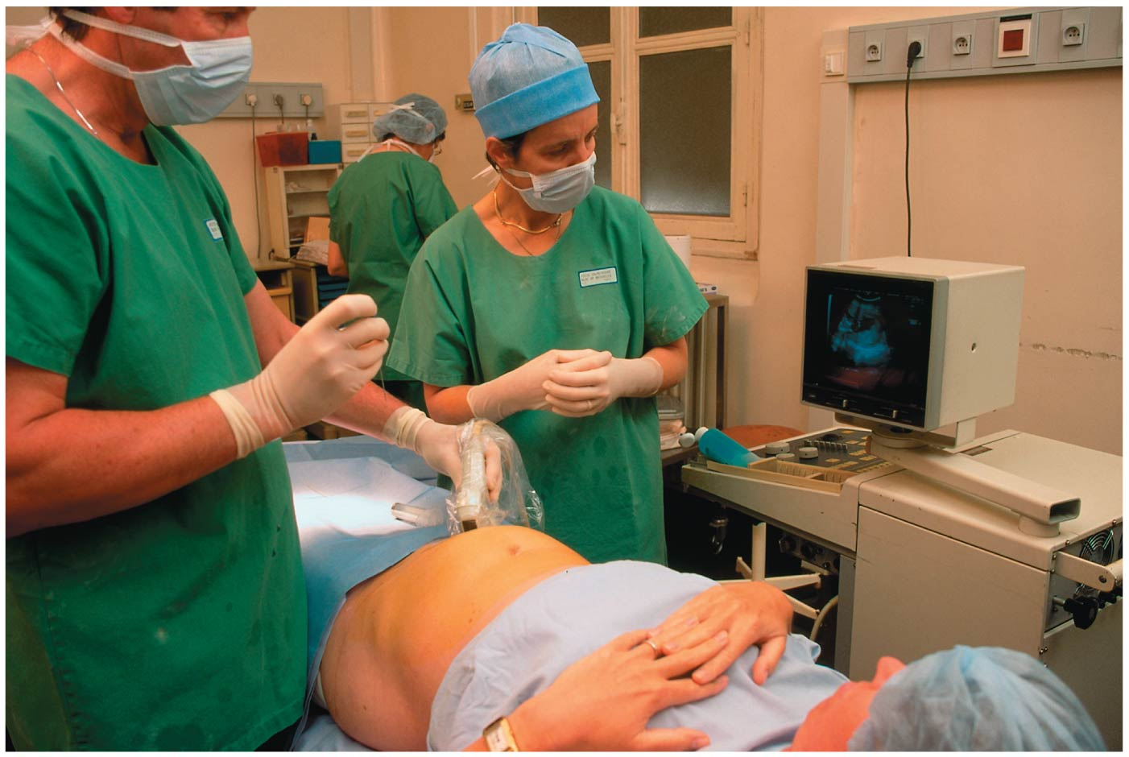
Figure 9.17
Notes:
Figure 9.17 Amniocentesis

Slide 23
Mendel’s Laws are bases that need a lot of improvement
Mendel’s two laws explain inheritance in terms of genes that are passed along from generation to generation according to simple rules of probability.
These laws are valid for all sexually reproducing organisms.
But Mendel’s laws stop short of explaining many patterns of genetic inheritance.
In fact, for most sexually reproducing organisms, cases in which Mendel’s rules can strictly account for the patterns of inheritance are relatively rare.
Notes:
23
Student Misconceptions and Concerns
1. As these variations of Mendel’s laws are introduced, students are likely to get confused and become uncertain about the prior definitions. Consider keeping a clear definition of these different patterns of inheritance available for the class to refer to as new patterns are discussed (perhaps as a handout for student reference).
2. As your class size increases, the chances increase that at least one student will have a family member with one of the genetic disorders discussed. Some students may find this embarrassing, but others might have a special interest in learning more about these topics, and may even be willing to share some of their family’s experiences with the class.
Teaching Tips
1. Incomplete dominance is analogous to a compromise, or a shade of gray. The key concept is that both “sides” have input. Complete dominance is more analogous to an authoritarian style, overruling others and insisting on things being a certain way. Although these analogies might seem obvious to us, many students new to genetics appreciate them.
2. Another analogy for cholesterol receptors is fishing poles. The more fishing poles you use, the more fish you will likely catch. Heterozygotes for hypercholesterolemia have fewer “fishing poles” for cholesterol. Thus, fewer “fish” are caught and more “fish” remain in the water.
3. Students can think of blood types as analogous to socks on their feet. You can have socks that match, a sock on one foot but not the other, you can wear two socks that do not match, or you can even go barefoot (type O blood)! Developed further, think of amber (A) and blue (B) socks. Type A blood can have an amber sock with either another amber sock or a bare foot (or “zero” sock). Blue socks work the same way. One amber and one blue sock represent the AB blood type. Having no socks, as already noted, represents type O.
4. Consider specifically comparing the principles of codominance (expression of both alleles) and incomplete dominance (expression of one intermediate trait). Students will likely benefit from this direct comparison.
5. The American Sickle Cell Anemia Association’s website (www.ascaa.org) is a good place to get additional details.
6. Polygenic inheritance makes it possible for children to inherit genes to be taller, or shorter, than either parent. Similarly, skin tones can be darker or lighter than either parent. The environment also contributes significantly to the final phenotype for both of these traits.
7. The authors note that polygenic inheritance is the converse of pleiotropy. This is worth noting in lecture as these concepts are discussed. We often remember concepts better when they are contrasted in pairs.
8. As the authors are careful to note, although genetics and the environment both contribute to the final phenotypes, only the genetic factors are inherited. This distinction is important to understanding the limitations of Lamarck’s mechanisms of evolution. If you will address principles of evolution soon after this chapter, this may be an important distinction to reinforce in lecture. References to tattoos, piercing, and circumcision may also help to distinguish between environmental influences and inheritance. Students with tattoos will not produce children born with tattoos! And for thousands of years, fathers who are circumcised have not fathered boys also circumcised!
Active Lecture Tips
1. See the activity Who Wants to Be a Millionaire? Inheritance on the Instructor Exchange. Visit the Instructor Exchange in the MasteringBiology instructor resource area for a description of this activity.

Slide 24
Incomplete Dominance불완전우성 in Plants and People
In incomplete dominance, F₁ hybrids have an appearance between the phenotypes of the two parents.
Notes:
24
Student Misconceptions and Concerns
1. As these variations of Mendel’s laws are introduced, students are likely to get confused and become uncertain about the prior definitions. Consider keeping a clear definition of these different patterns of inheritance available for the class to refer to as new patterns are discussed (perhaps as a handout for student reference).
2. As your class size increases, the chances increase that at least one student will have a family member with one of the genetic disorders discussed. Some students may find this embarrassing, but others might have a special interest in learning more about these topics, and may even be willing to share some of their family’s experiences with the class.
Teaching Tips
1. Incomplete dominance is analogous to a compromise, or a shade of gray. The key concept is that both “sides” have input. Complete dominance is more analogous to an authoritarian style, overruling others and insisting on things being a certain way. Although these analogies might seem obvious to us, many students new to genetics appreciate them.
2. Another analogy for cholesterol receptors is fishing poles. The more fishing poles you use, the more fish you will likely catch. Heterozygotes for hypercholesterolemia have fewer “fishing poles” for cholesterol. Thus, fewer “fish” are caught and more “fish” remain in the water.
3. Students can think of blood types as analogous to socks on their feet. You can have socks that match, a sock on one foot but not the other, you can wear two socks that do not match, or you can even go barefoot (type O blood)! Developed further, think of amber (A) and blue (B) socks. Type A blood can have an amber sock with either another amber sock or a bare foot (or “zero” sock). Blue socks work the same way. One amber and one blue sock represent the AB blood type. Having no socks, as already noted, represents type O.
4. Consider specifically comparing the principles of codominance (expression of both alleles) and incomplete dominance (expression of one intermediate trait). Students will likely benefit from this direct comparison.
5. The American Sickle Cell Anemia Association’s website (www.ascaa.org) is a good place to get additional details.
6. Polygenic inheritance makes it possible for children to inherit genes to be taller, or shorter, than either parent. Similarly, skin tones can be darker or lighter than either parent. The environment also contributes significantly to the final phenotype for both of these traits.
7. The authors note that polygenic inheritance is the converse of pleiotropy. This is worth noting in lecture as these concepts are discussed. We often remember concepts better when they are contrasted in pairs.
8. As the authors are careful to note, although genetics and the environment both contribute to the final phenotypes, only the genetic factors are inherited. This distinction is important to understanding the limitations of Lamarck’s mechanisms of evolution. If you will address principles of evolution soon after this chapter, this may be an important distinction to reinforce in lecture. References to tattoos, piercing, and circumcision may also help to distinguish between environmental influences and inheritance. Students with tattoos will not produce children born with tattoos! And for thousands of years, fathers who are circumcised have not fathered boys also circumcised!
Active Lecture Tips
1. See the activity Who Wants to Be a Millionaire? Inheritance on the Instructor Exchange. Visit the Instructor Exchange in the MasteringBiology instructor resource area for a description of this activity.

Slide 25
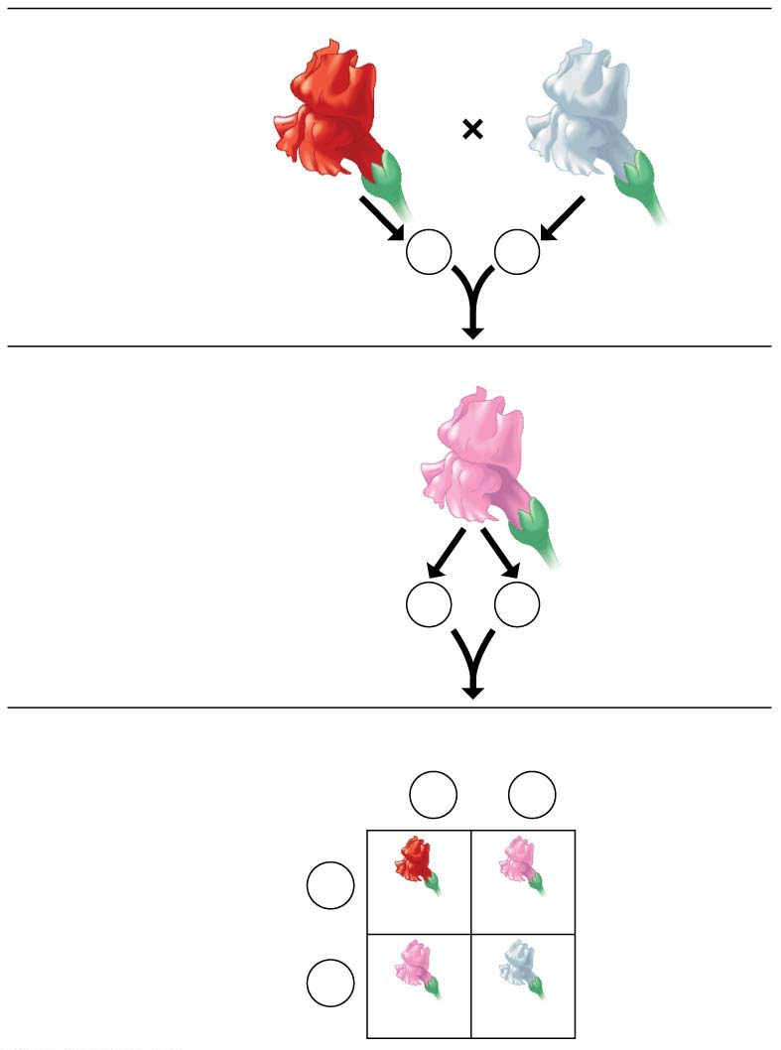
Figure 9.18-s3
P Generation
금어초
Red
RR
White
rr
Gametes
R
r
F₁ Generation
Pink
Rr
Gametes
1
2
R
1
2
r
F₂ Generation
Sperm
1
2
R
1
2
r
1
2
R
Eggs
RR
Rr
1
2
r
Rr
rr
Notes:
Figure 9.18-s3 Incomplete dominance in snapdragons (step 3)

Slide 26
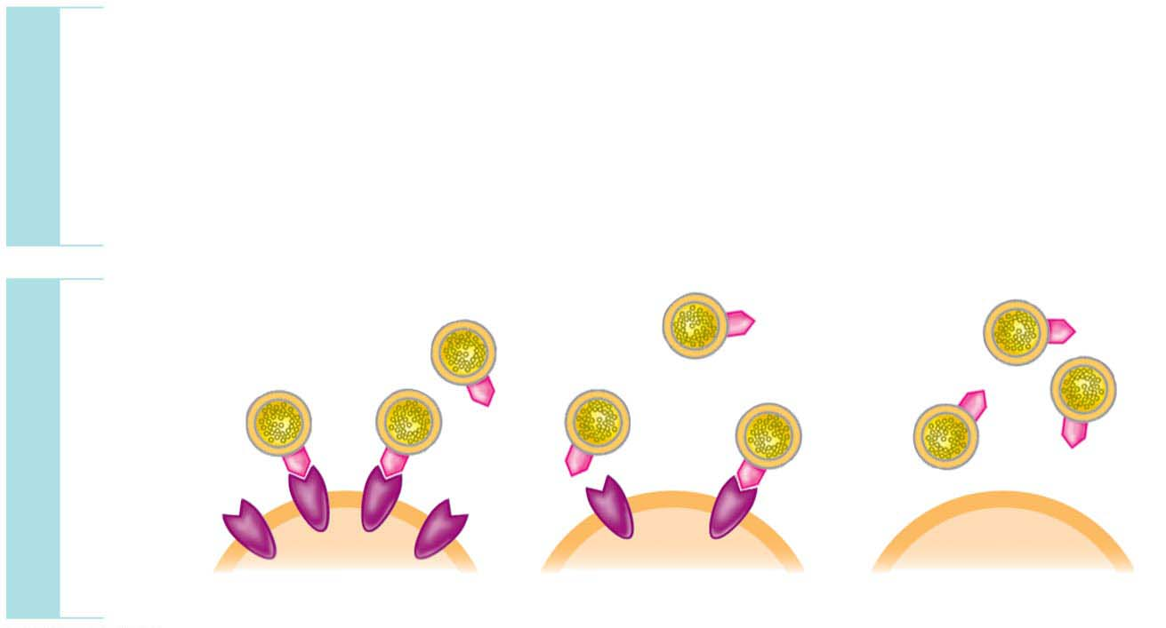
Figure 9.19
In hypercholesterolemia콜레스트롤 과잉혈증,
heterozygotes have blood cholesterol levels about twice normal, while
homozygotes have about five times the normal amount of blood cholesterol and may have heart attacks as early as age 2.
GENOTYPE
HH
Homozygous
for ability to make
LDL receptors
hh
Homozygous
for inability to make
LDL receptors
Hh
Heterozygous
LDL
PHENOTYPE
LDL
receptor
Cell
Normal
Mild disease
Severe disease
Notes:
Figure 9.19 Incomplete dominance in human hypercholesterolemia

Slide 27
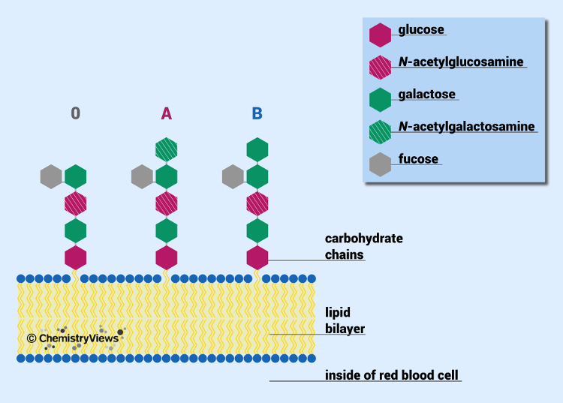
ABO Blood Groups: An Example of Multiple Alleles and Codominance공동우성
The ABO blood groups in humans involve three alleles of a single gene.
Various combinations of these three alleles produce four phenotypes: A person’s blood type may be A, B, AB, or O.
These letters refer to two carbohydrates, designated A and B, that may be found on the surface of red blood cells.
Notes:
27
Student Misconceptions and Concerns
1. As these variations of Mendel’s laws are introduced, students are likely to get confused and become uncertain about the prior definitions. Consider keeping a clear definition of these different patterns of inheritance available for the class to refer to as new patterns are discussed (perhaps as a handout for student reference).
2. As your class size increases, the chances increase that at least one student will have a family member with one of the genetic disorders discussed. Some students may find this embarrassing, but others might have a special interest in learning more about these topics, and may even be willing to share some of their family’s experiences with the class.
Teaching Tips
1. Incomplete dominance is analogous to a compromise, or a shade of gray. The key concept is that both “sides” have input. Complete dominance is more analogous to an authoritarian style, overruling others and insisting on things being a certain way. Although these analogies might seem obvious to us, many students new to genetics appreciate them.
2. Another analogy for cholesterol receptors is fishing poles. The more fishing poles you use, the more fish you will likely catch. Heterozygotes for hypercholesterolemia have fewer “fishing poles” for cholesterol. Thus, fewer “fish” are caught and more “fish” remain in the water.
3. Students can think of blood types as analogous to socks on their feet. You can have socks that match, a sock on one foot but not the other, you can wear two socks that do not match, or you can even go barefoot (type O blood)! Developed further, think of amber (A) and blue (B) socks. Type A blood can have an amber sock with either another amber sock or a bare foot (or “zero” sock). Blue socks work the same way. One amber and one blue sock represent the AB blood type. Having no socks, as already noted, represents type O.
4. Consider specifically comparing the principles of codominance (expression of both alleles) and incomplete dominance (expression of one intermediate trait). Students will likely benefit from this direct comparison.
5. The American Sickle Cell Anemia Association’s website (www.ascaa.org) is a good place to get additional details.
6. Polygenic inheritance makes it possible for children to inherit genes to be taller, or shorter, than either parent. Similarly, skin tones can be darker or lighter than either parent. The environment also contributes significantly to the final phenotype for both of these traits.
7. The authors note that polygenic inheritance is the converse of pleiotropy. This is worth noting in lecture as these concepts are discussed. We often remember concepts better when they are contrasted in pairs.
8. As the authors are careful to note, although genetics and the environment both contribute to the final phenotypes, only the genetic factors are inherited. This distinction is important to understanding the limitations of Lamarck’s mechanisms of evolution. If you will address principles of evolution soon after this chapter, this may be an important distinction to reinforce in lecture. References to tattoos, piercing, and circumcision may also help to distinguish between environmental influences and inheritance. Students with tattoos will not produce children born with tattoos! And for thousands of years, fathers who are circumcised have not fathered boys also circumcised!
Active Lecture Tips
1. See the activity Who Wants to Be a Millionaire? Inheritance on the Instructor Exchange. Visit the Instructor Exchange in the MasteringBiology instructor resource area for a description of this activity.

Slide 28
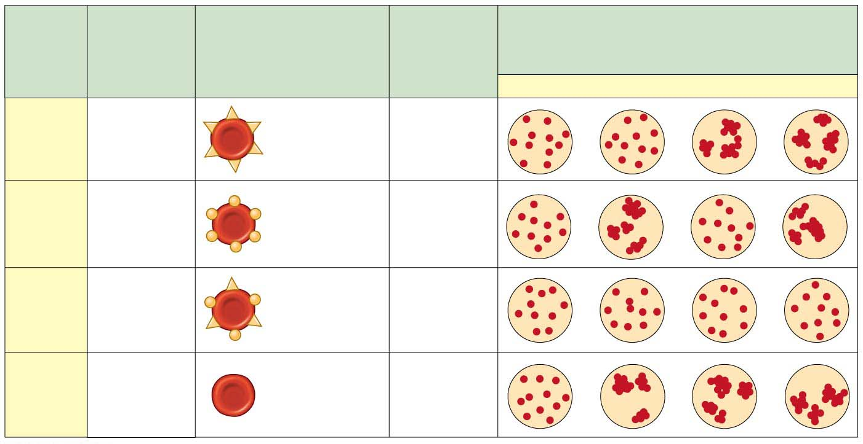
Figure 9.20
Blood
Group
(Pheno-
type)
Reactions When Blood from Groups
Below Is Mixed with Antibodies from
Groups at Left
Antibodies
Present in
Blood
Genotypes
Red Blood Cells
O
A
B
AB
I^{A} I^{A}
Carbohydrate
A
A
or
Anti-B
I^{A}i
I^{B} I^{B}
Carbohydrate
B
B
or
Anti-A
I^{B} i
AB
I^{A} I^{B}
O
^{ii}
Anti-A
Anti-B
Both the I^{A} and I^{B} alleles are dominant to the i allele.
People of genotype I^{A}I^{B} make both carbohydrates. In other words, the I^{A} and I^{B} alleles are codominant, meaning that both alleles are expressed in heterozygous individuals (I^{A}I^{B}) who have type AB blood.
isoagglutinogen
Notes:
Figure 9.20 Multiple alleles for the ABO blood groups

Slide 29
Pleiotropy다면발현
Pleiotropy is when one gene influences several characters.
Sickle-cell겸상적혈구 disease
exhibits pleiotropy,
results in abnormal hemoglobin proteins, and
causes disk-shaped red blood cells to deform into a sickle shape with jagged edges.
In most cases, only people who are homozygous for the sickle-cell allele have sickle-cell disease.
Notes:
29
Student Misconceptions and Concerns
1. As these variations of Mendel’s laws are introduced, students are likely to get confused and become uncertain about the prior definitions. Consider keeping a clear definition of these different patterns of inheritance available for the class to refer to as new patterns are discussed (perhaps as a handout for student reference).
2. As your class size increases, the chances increase that at least one student will have a family member with one of the genetic disorders discussed. Some students may find this embarrassing, but others might have a special interest in learning more about these topics, and may even be willing to share some of their family’s experiences with the class.
Teaching Tips
1. Incomplete dominance is analogous to a compromise, or a shade of gray. The key concept is that both “sides” have input. Complete dominance is more analogous to an authoritarian style, overruling others and insisting on things being a certain way. Although these analogies might seem obvious to us, many students new to genetics appreciate them.
2. Another analogy for cholesterol receptors is fishing poles. The more fishing poles you use, the more fish you will likely catch. Heterozygotes for hypercholesterolemia have fewer “fishing poles” for cholesterol. Thus, fewer “fish” are caught and more “fish” remain in the water.
3. Students can think of blood types as analogous to socks on their feet. You can have socks that match, a sock on one foot but not the other, you can wear two socks that do not match, or you can even go barefoot (type O blood)! Developed further, think of amber (A) and blue (B) socks. Type A blood can have an amber sock with either another amber sock or a bare foot (or “zero” sock). Blue socks work the same way. One amber and one blue sock represent the AB blood type. Having no socks, as already noted, represents type O.
4. Consider specifically comparing the principles of codominance (expression of both alleles) and incomplete dominance (expression of one intermediate trait). Students will likely benefit from this direct comparison.
5. The American Sickle Cell Anemia Association’s website (www.ascaa.org) is a good place to get additional details.
6. Polygenic inheritance makes it possible for children to inherit genes to be taller, or shorter, than either parent. Similarly, skin tones can be darker or lighter than either parent. The environment also contributes significantly to the final phenotype for both of these traits.
7. The authors note that polygenic inheritance is the converse of pleiotropy. This is worth noting in lecture as these concepts are discussed. We often remember concepts better when they are contrasted in pairs.
8. As the authors are careful to note, although genetics and the environment both contribute to the final phenotypes, only the genetic factors are inherited. This distinction is important to understanding the limitations of Lamarck’s mechanisms of evolution. If you will address principles of evolution soon after this chapter, this may be an important distinction to reinforce in lecture. References to tattoos, piercing, and circumcision may also help to distinguish between environmental influences and inheritance. Students with tattoos will not produce children born with tattoos! And for thousands of years, fathers who are circumcised have not fathered boys also circumcised!
Active Lecture Tips
1. See the activity Who Wants to Be a Millionaire? Inheritance on the Instructor Exchange. Visit the Instructor Exchange in the MasteringBiology instructor resource area for a description of this activity.

Slide 30
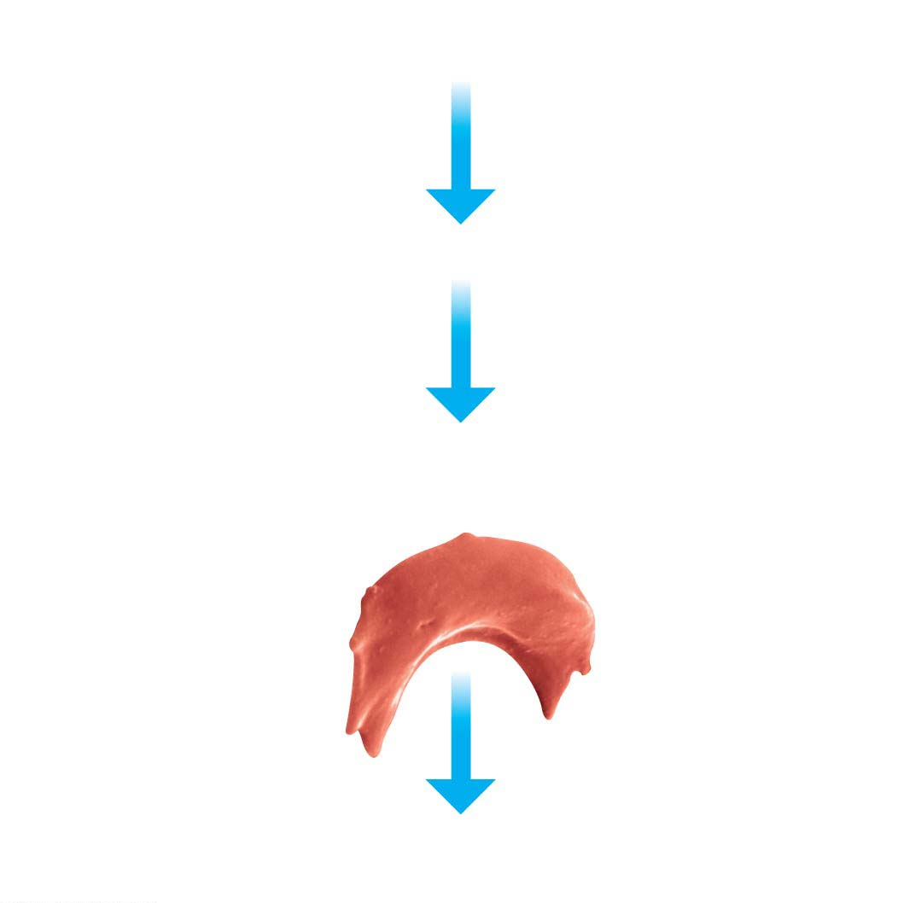
Figure 9.21
Individual homozygous
for sickle-cell allele
Sickle-cell (abnormal) hemoglobin
Abnormal hemoglobin crystallizes into long, flexible chains,
causing red blood cells to become sickle-shaped.
Colorized SEM
Sickled cells can lead to a cascade of symptoms, such as
weakness, pain, organ damage, and paralysis.
Notes:
Figure 9.21 Sickle-cell disease: multiple effects of a single human gene

Slide 31
Polygenic Inheritance다인자유전
Polygenic inheritance is
the additive effects of two or more genes on a single phenotypic character and
the logical opposite of pleiotropy, in which one gene affects several characters.
There are evidences that height in people is controlled by a great number of genes.
Notes:
31
Student Misconceptions and Concerns
1. As these variations of Mendel’s laws are introduced, students are likely to get confused and become uncertain about the prior definitions. Consider keeping a clear definition of these different patterns of inheritance available for the class to refer to as new patterns are discussed (perhaps as a handout for student reference).
2. As your class size increases, the chances increase that at least one student will have a family member with one of the genetic disorders discussed. Some students may find this embarrassing, but others might have a special interest in learning more about these topics, and may even be willing to share some of their family’s experiences with the class.
Teaching Tips
1. Incomplete dominance is analogous to a compromise, or a shade of gray. The key concept is that both “sides” have input. Complete dominance is more analogous to an authoritarian style, overruling others and insisting on things being a certain way. Although these analogies might seem obvious to us, many students new to genetics appreciate them.
2. Another analogy for cholesterol receptors is fishing poles. The more fishing poles you use, the more fish you will likely catch. Heterozygotes for hypercholesterolemia have fewer “fishing poles” for cholesterol. Thus, fewer “fish” are caught and more “fish” remain in the water.
3. Students can think of blood types as analogous to socks on their feet. You can have socks that match, a sock on one foot but not the other, you can wear two socks that do not match, or you can even go barefoot (type O blood)! Developed further, think of amber (A) and blue (B) socks. Type A blood can have an amber sock with either another amber sock or a bare foot (or “zero” sock). Blue socks work the same way. One amber and one blue sock represent the AB blood type. Having no socks, as already noted, represents type O.
4. Consider specifically comparing the principles of codominance (expression of both alleles) and incomplete dominance (expression of one intermediate trait). Students will likely benefit from this direct comparison.
5. The American Sickle Cell Anemia Association’s website (www.ascaa.org) is a good place to get additional details.
6. Polygenic inheritance makes it possible for children to inherit genes to be taller, or shorter, than either parent. Similarly, skin tones can be darker or lighter than either parent. The environment also contributes significantly to the final phenotype for both of these traits.
7. The authors note that polygenic inheritance is the converse of pleiotropy. This is worth noting in lecture as these concepts are discussed. We often remember concepts better when they are contrasted in pairs.
8. As the authors are careful to note, although genetics and the environment both contribute to the final phenotypes, only the genetic factors are inherited. This distinction is important to understanding the limitations of Lamarck’s mechanisms of evolution. If you will address principles of evolution soon after this chapter, this may be an important distinction to reinforce in lecture. References to tattoos, piercing, and circumcision may also help to distinguish between environmental influences and inheritance. Students with tattoos will not produce children born with tattoos! And for thousands of years, fathers who are circumcised have not fathered boys also circumcised!
Active Lecture Tips
1. See the activity Who Wants to Be a Millionaire? Inheritance on the Instructor Exchange. Visit the Instructor Exchange in the MasteringBiology instructor resource area for a description of this activity.

Slide 32
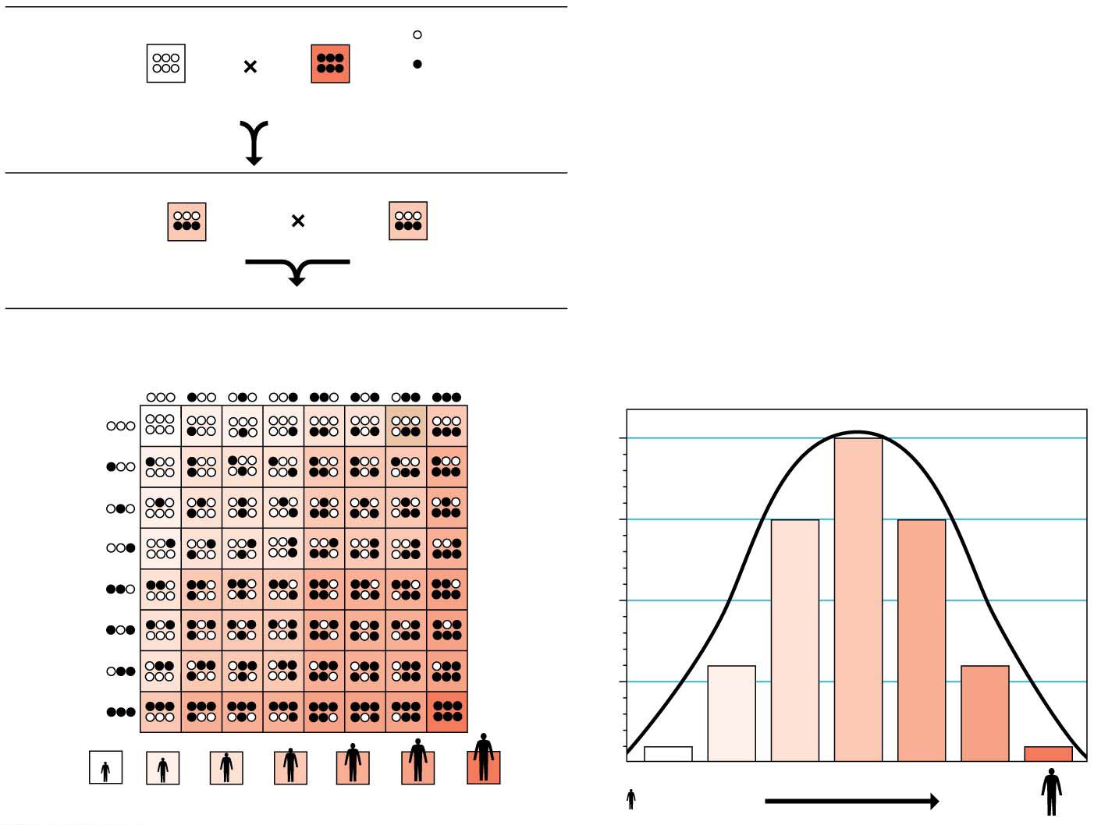
Figure 9.22
P Generation
= short allele
= tall allele
aabbcc
(very short)
AABBCC
(very tall)
F₁ Generation
AaBbCc
(medium height)
AaBbCc
(medium height)
F₂ Generation
Sperm
1
8
1
8
1
8
1
8
1
8
1
8
1
8
1
8
1
8
20
64
1
8
1
8
15
64
1
8
Eggs
1
8
Fraction of population
1
8
1
8
6
64
1
8
1
64
1
64
6
64
15
64
20
64
15
64
6
64
1
64
Very short
Adult height
Very tall
Notes:
Figure 9.22 A model for polygenic inheritance of height

Slide 33
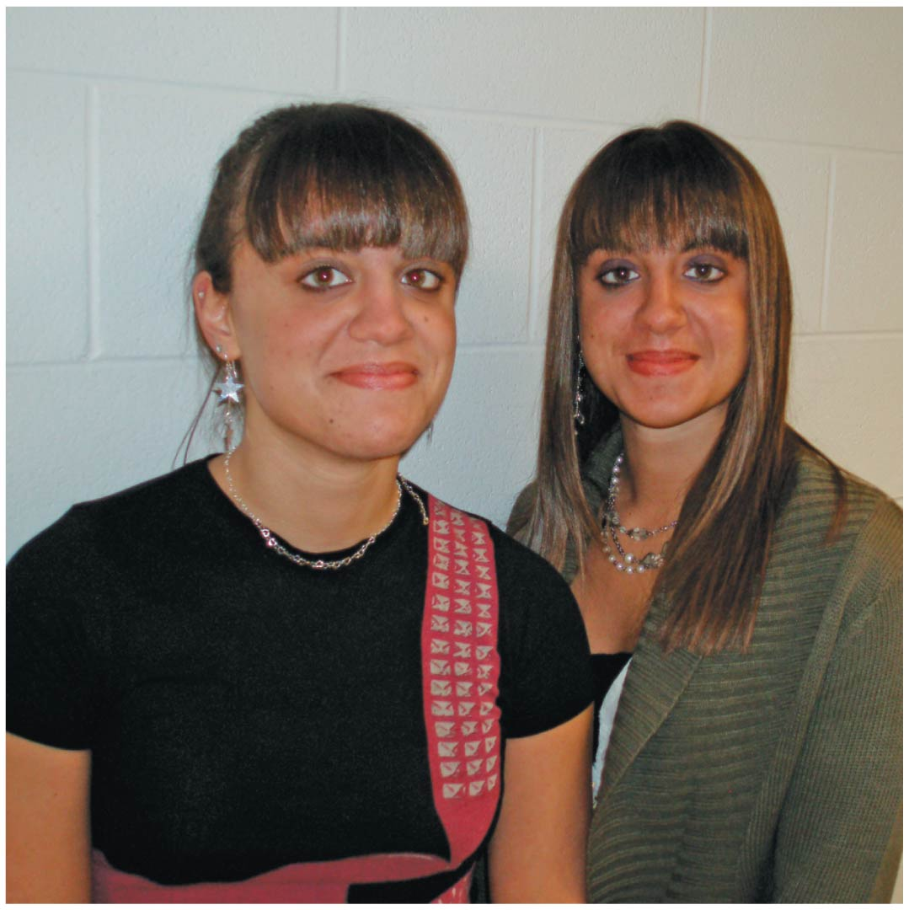
Epigenetics후성유전학 and the Role of Environment
Many phenotypic characters result from a combination of heredity and environment.
Whether human characters are more influenced by genes or by the environment—nature or nurture—is a very old and hotly contested issue.
Spending time with identical twins will convince anyone that environment, and not just genes, affects a person’s traits.
Notes:
33
Student Misconceptions and Concerns
1. As these variations of Mendel’s laws are introduced, students are likely to get confused and become uncertain about the prior definitions. Consider keeping a clear definition of these different patterns of inheritance available for the class to refer to as new patterns are discussed (perhaps as a handout for student reference).
2. As your class size increases, the chances increase that at least one student will have a family member with one of the genetic disorders discussed. Some students may find this embarrassing, but others might have a special interest in learning more about these topics, and may even be willing to share some of their family’s experiences with the class.
Teaching Tips
1. Incomplete dominance is analogous to a compromise, or a shade of gray. The key concept is that both “sides” have input. Complete dominance is more analogous to an authoritarian style, overruling others and insisting on things being a certain way. Although these analogies might seem obvious to us, many students new to genetics appreciate them.
2. Another analogy for cholesterol receptors is fishing poles. The more fishing poles you use, the more fish you will likely catch. Heterozygotes for hypercholesterolemia have fewer “fishing poles” for cholesterol. Thus, fewer “fish” are caught and more “fish” remain in the water.
3. Students can think of blood types as analogous to socks on their feet. You can have socks that match, a sock on one foot but not the other, you can wear two socks that do not match, or you can even go barefoot (type O blood)! Developed further, think of amber (A) and blue (B) socks. Type A blood can have an amber sock with either another amber sock or a bare foot (or “zero” sock). Blue socks work the same way. One amber and one blue sock represent the AB blood type. Having no socks, as already noted, represents type O.
4. Consider specifically comparing the principles of codominance (expression of both alleles) and incomplete dominance (expression of one intermediate trait). Students will likely benefit from this direct comparison.
5. The American Sickle Cell Anemia Association’s website (www.ascaa.org) is a good place to get additional details.
6. Polygenic inheritance makes it possible for children to inherit genes to be taller, or shorter, than either parent. Similarly, skin tones can be darker or lighter than either parent. The environment also contributes significantly to the final phenotype for both of these traits.
7. The authors note that polygenic inheritance is the converse of pleiotropy. This is worth noting in lecture as these concepts are discussed. We often remember concepts better when they are contrasted in pairs.
8. As the authors are careful to note, although genetics and the environment both contribute to the final phenotypes, only the genetic factors are inherited. This distinction is important to understanding the limitations of Lamarck’s mechanisms of evolution. If you will address principles of evolution soon after this chapter, this may be an important distinction to reinforce in lecture. References to tattoos, piercing, and circumcision may also help to distinguish between environmental influences and inheritance. Students with tattoos will not produce children born with tattoos! And for thousands of years, fathers who are circumcised have not fathered boys also circumcised!
Active Lecture Tips
1. See the activity Who Wants to Be a Millionaire? Inheritance on the Instructor Exchange. Visit the Instructor Exchange in the MasteringBiology instructor resource area for a description of this activity.

Slide 34
In general, only genetic influences are inherited and effects of the environment are not passed to the next generation.
In recent years, however, biologists have begun to recognize the importance of epigenetic inheritance, the transmission of traits by mechanisms not directly involving DNA sequence.
For example, components of chromosomes can be chemically modified by adding or removing chemical groups on the DNA and/or protein components of chromosomes.
Epigenetic modifications—and the changes in gene activity that result—may even be carried on to the next generation.
Unlike alterations to the DNA sequence, chemical changes to the chromosomes can be reversed.
Notes:
34
Student Misconceptions and Concerns
1. As these variations of Mendel’s laws are introduced, students are likely to get confused and become uncertain about the prior definitions. Consider keeping a clear definition of these different patterns of inheritance available for the class to refer to as new patterns are discussed (perhaps as a handout for student reference).
2. As your class size increases, the chances increase that at least one student will have a family member with one of the genetic disorders discussed. Some students may find this embarrassing, but others might have a special interest in learning more about these topics, and may even be willing to share some of their family’s experiences with the class.
Teaching Tips
1. Incomplete dominance is analogous to a compromise, or a shade of gray. The key concept is that both “sides” have input. Complete dominance is more analogous to an authoritarian style, overruling others and insisting on things being a certain way. Although these analogies might seem obvious to us, many students new to genetics appreciate them.
2. Another analogy for cholesterol receptors is fishing poles. The more fishing poles you use, the more fish you will likely catch. Heterozygotes for hypercholesterolemia have fewer “fishing poles” for cholesterol. Thus, fewer “fish” are caught and more “fish” remain in the water.
3. Students can think of blood types as analogous to socks on their feet. You can have socks that match, a sock on one foot but not the other, you can wear two socks that do not match, or you can even go barefoot (type O blood)! Developed further, think of amber (A) and blue (B) socks. Type A blood can have an amber sock with either another amber sock or a bare foot (or “zero” sock). Blue socks work the same way. One amber and one blue sock represent the AB blood type. Having no socks, as already noted, represents type O.
4. Consider specifically comparing the principles of codominance (expression of both alleles) and incomplete dominance (expression of one intermediate trait). Students will likely benefit from this direct comparison.
5. The American Sickle Cell Anemia Association’s website (www.ascaa.org) is a good place to get additional details.
6. Polygenic inheritance makes it possible for children to inherit genes to be taller, or shorter, than either parent. Similarly, skin tones can be darker or lighter than either parent. The environment also contributes significantly to the final phenotype for both of these traits.
7. The authors note that polygenic inheritance is the converse of pleiotropy. This is worth noting in lecture as these concepts are discussed. We often remember concepts better when they are contrasted in pairs.
8. As the authors are careful to note, although genetics and the environment both contribute to the final phenotypes, only the genetic factors are inherited. This distinction is important to understanding the limitations of Lamarck’s mechanisms of evolution. If you will address principles of evolution soon after this chapter, this may be an important distinction to reinforce in lecture. References to tattoos, piercing, and circumcision may also help to distinguish between environmental influences and inheritance. Students with tattoos will not produce children born with tattoos! And for thousands of years, fathers who are circumcised have not fathered boys also circumcised!
Active Lecture Tips
1. See the activity Who Wants to Be a Millionaire? Inheritance on the Instructor Exchange. Visit the Instructor Exchange in the MasteringBiology instructor resource area for a description of this activity.

Slide 35
The Chromosomal Basis of Inheritance
The chromosome theory염색체설 of inheritance states that
genes are located at specific positions (loci) on chromosomes and
the behavior of chromosomes during meiosis and fertilization accounts for inheritance patterns.
Linked genes
are located near each other on the same chromosome and
tend to travel together during meiosis and fertilization.
Such genes are often inherited as a set and therefore often do not follow Mendel’s law of independent assortment.
Notes:
35
Student Misconceptions and Concerns
1. This section of the chapter relies on a good understanding of the chromosome sorting process of meiosis. If students were not assigned Chapter 8, and meiosis was not otherwise addressed, it will be difficult for students to understand the chromosomal basis of inheritance or linked genes.
2. The nature of linked genes builds on our natural expectations that items that are closer together are less likely to be separated. Yet students may find such concepts initially foreign. Whether it is parents holding the hands of children or people and their pets, we generally know that separation is more likely when things are farther apart. You might demonstrate this simply by drawing a line down a page of text. The likelihood that the line separates any pair of words increases, as the distance between the words grows farther apart.
3. The discussion of “linked genes” addresses a different relationship than the use of the similar termed “sex-linked genes.” The nature of the linkage is quite different. Consider emphasizing this distinction for your students.
4. The likelihood that at least some students are colorblind in larger classes is very high. Some of these students might find this interesting and want to discuss it further. However, others might be embarrassed by what might be perceived as a defect.
Teaching Tips
1. Building on the shoe analogy developed in Chapter 8, linked genes are like a shoe and its shoelaces. The two are usually transferred together but can be moved separately under special circumstances.
2. Crossing over (from Chapter 8) is like randomly editing out a minute of film from two movies and swapping them. Perhaps the fifth minute of Bambi is swapped for the fifth minute of a Shrek film. Clearly, the closer that two frames of film are together, the more likely they are to move or remain together.
3. In some ways, sex-linked genes reflect the risk of not having a backup copy of a file on your computer. If you only have one copy and it is damaged, you have to live with the damaged file. Having two X chromosomes in females provides a “backup copy” that can function if one of the sex-linked genes is damaged.
4. Hemophilia and other genetic diseases may also result from spontaneous mutations in a family with no known history of the disease. Although rare, this possibility should always be considered when tracing the history of an inherited disease.
5. Female hemophiliacs are very rare because both X chromosomes would need to have the recessive trait. Although very unlikely, female hemophiliacs are known. Students may enjoy searching for details of these rare cases. For additional information about hemophilia, consider visiting the website of the National Hemophilia Foundation at www.hemophilia.org.
Active Lecture Tips
1. See the activity Pairs of Shoes and Pairs of Chromosomes on the Instructor Exchange. Visit the Instructor Exchange in the MasteringBiology instructor resource area for a description of this activity.
2. See the Media Review: “Learn.Genetics” Genetic Science Learning Center from the University of Utah on the Instructor Exchange. Visit the Instructor Exchange in the MasteringBiology instructor resource area for a description of this activity.

Slide 36
Sex Determination in Humans
Many animals, including all mammals, have a pair of sex chromosomes, designated X and Y, that determine an individual’s sex.
Individuals with one X chromosome and one Y chromosome are males.
XX individuals are females.
Human males and females both have 44 autosomes (chromosomes other than sex chromosomes).
A gene located on a sex chromosome is called a sex-linked gene반성유전자.
Most sex-linked genes are found on the X chromosome.
Notes:
36
Student Misconceptions and Concerns
1. This section of the chapter relies on a good understanding of the chromosome sorting process of meiosis. If students were not assigned Chapter 8, and meiosis was not otherwise addressed, it will be difficult for students to understand the chromosomal basis of inheritance or linked genes.
2. The nature of linked genes builds on our natural expectations that items that are closer together are less likely to be separated. Yet students may find such concepts initially foreign. Whether it is parents holding the hands of children or people and their pets, we generally know that separation is more likely when things are farther apart. You might demonstrate this simply by drawing a line down a page of text. The likelihood that the line separates any pair of words increases, as the distance between the words grows farther apart.
3. The discussion of “linked genes” addresses a different relationship than the use of the similar termed “sex-linked genes.” The nature of the linkage is quite different. Consider emphasizing this distinction for your students.
4. The likelihood that at least some students are colorblind in larger classes is very high. Some of these students might find this interesting and want to discuss it further. However, others might be embarrassed by what might be perceived as a defect.
Teaching Tips
1. Building on the shoe analogy developed in Chapter 8, linked genes are like a shoe and its shoelaces. The two are usually transferred together but can be moved separately under special circumstances.
2. Crossing over (from Chapter 8) is like randomly editing out a minute of film from two movies and swapping them. Perhaps the fifth minute of Bambi is swapped for the fifth minute of a Shrek film. Clearly, the closer that two frames of film are together, the more likely they are to move or remain together.
3. In some ways, sex-linked genes reflect the risk of not having a backup copy of a file on your computer. If you only have one copy and it is damaged, you have to live with the damaged file. Having two X chromosomes in females provides a “backup copy” that can function if one of the sex-linked genes is damaged.
4. Hemophilia and other genetic diseases may also result from spontaneous mutations in a family with no known history of the disease. Although rare, this possibility should always be considered when tracing the history of an inherited disease.
5. Female hemophiliacs are very rare because both X chromosomes would need to have the recessive trait. Although very unlikely, female hemophiliacs are known. Students may enjoy searching for details of these rare cases. For additional information about hemophilia, consider visiting the website of the National Hemophilia Foundation at www.hemophilia.org.
Active Lecture Tips
1. See the activity Pairs of Shoes and Pairs of Chromosomes on the Instructor Exchange. Visit the Instructor Exchange in the MasteringBiology instructor resource area for a description of this activity.
2. See the Media Review: “Learn.Genetics” Genetic Science Learning Center from the University of Utah on the Instructor Exchange. Visit the Instructor Exchange in the MasteringBiology instructor resource area for a description of this activity.

Slide 37
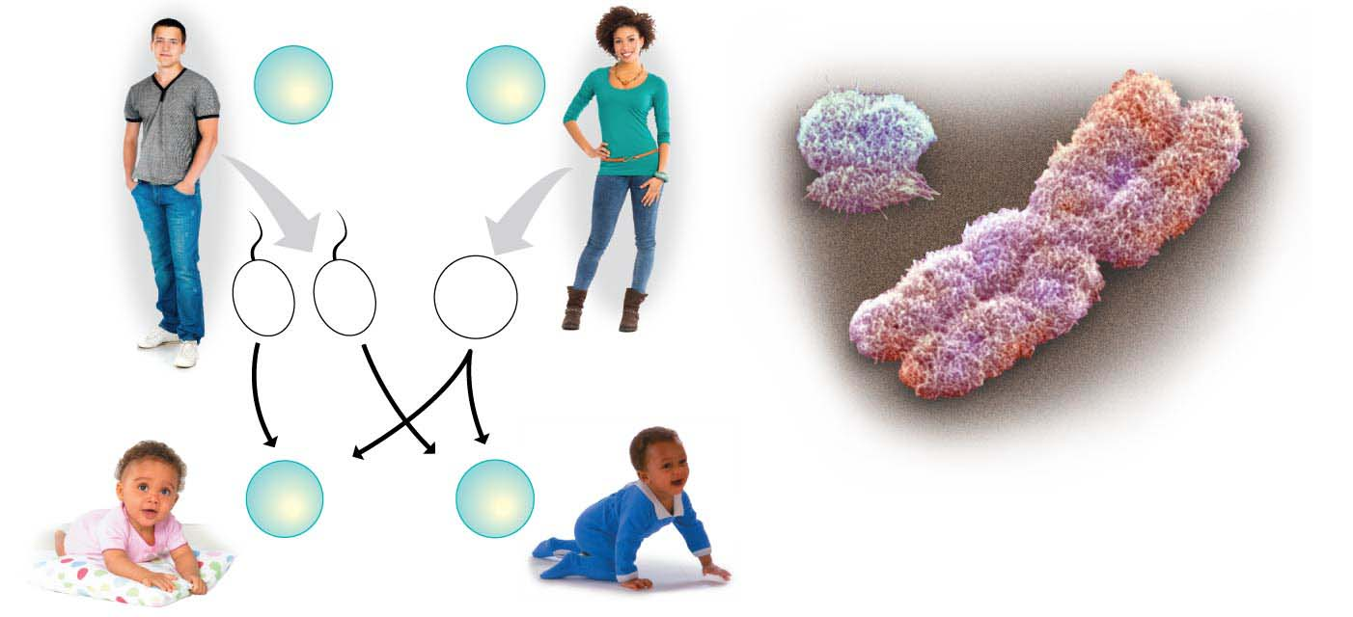
Figure 9.25
Male
Female
44
+
XY
Somatic
cells
44
+
XX
Y
X
Colorized SEM
22
+
X
22
+
Y
22
+
X
Sperm
Egg
44
+
XX
44
+
XY
Offspring
Female
Male
Notes:
Figure 9.25 The chromosomal basis of sex determination in humans

Slide 38
A number of human conditions, including red-green colorblindness, hemophilia, and a type of muscular dystrophy, result from sex-linked recessive alleles.
Red-green colorblindness is a common sex-linked disorder caused by a malfunction of light-sensitive cells in the eyes.
Mostly males are affected, but heterozygous females have some defects, too.
Because they are located on the sex chromosomes, sex-linked genes exhibit unusual inheritance patterns.
Because the colorblindness allele is recessive, a female will be colorblind only if she receives that allele on both X chromosomes.
Notes:
38
Student Misconceptions and Concerns
1. This section of the chapter relies on a good understanding of the chromosome sorting process of meiosis. If students were not assigned Chapter 8, and meiosis was not otherwise addressed, it will be difficult for students to understand the chromosomal basis of inheritance or linked genes.
2. The nature of linked genes builds on our natural expectations that items that are closer together are less likely to be separated. Yet students may find such concepts initially foreign. Whether it is parents holding the hands of children or people and their pets, we generally know that separation is more likely when things are farther apart. You might demonstrate this simply by drawing a line down a page of text. The likelihood that the line separates any pair of words increases, as the distance between the words grows farther apart.
3. The discussion of “linked genes” addresses a different relationship than the use of the similar termed “sex-linked genes.” The nature of the linkage is quite different. Consider emphasizing this distinction for your students.
4. The likelihood that at least some students are colorblind in larger classes is very high. Some of these students might find this interesting and want to discuss it further. However, others might be embarrassed by what might be perceived as a defect.
Teaching Tips
1. Building on the shoe analogy developed in Chapter 8, linked genes are like a shoe and its shoelaces. The two are usually transferred together but can be moved separately under special circumstances.
2. Crossing over (from Chapter 8) is like randomly editing out a minute of film from two movies and swapping them. Perhaps the fifth minute of Bambi is swapped for the fifth minute of a Shrek film. Clearly, the closer that two frames of film are together, the more likely they are to move or remain together.
3. In some ways, sex-linked genes reflect the risk of not having a backup copy of a file on your computer. If you only have one copy and it is damaged, you have to live with the damaged file. Having two X chromosomes in females provides a “backup copy” that can function if one of the sex-linked genes is damaged.
4. Hemophilia and other genetic diseases may also result from spontaneous mutations in a family with no known history of the disease. Although rare, this possibility should always be considered when tracing the history of an inherited disease.
5. Female hemophiliacs are very rare because both X chromosomes would need to have the recessive trait. Although very unlikely, female hemophiliacs are known. Students may enjoy searching for details of these rare cases. For additional information about hemophilia, consider visiting the website of the National Hemophilia Foundation at www.hemophilia.org.
Active Lecture Tips
1. See the activity Pairs of Shoes and Pairs of Chromosomes on the Instructor Exchange. Visit the Instructor Exchange in the MasteringBiology instructor resource area for a description of this activity.
2. See the Media Review: “Learn.Genetics” Genetic Science Learning Center from the University of Utah on the Instructor Exchange. Visit the Instructor Exchange in the MasteringBiology instructor resource area for a description of this activity.

Slide 39
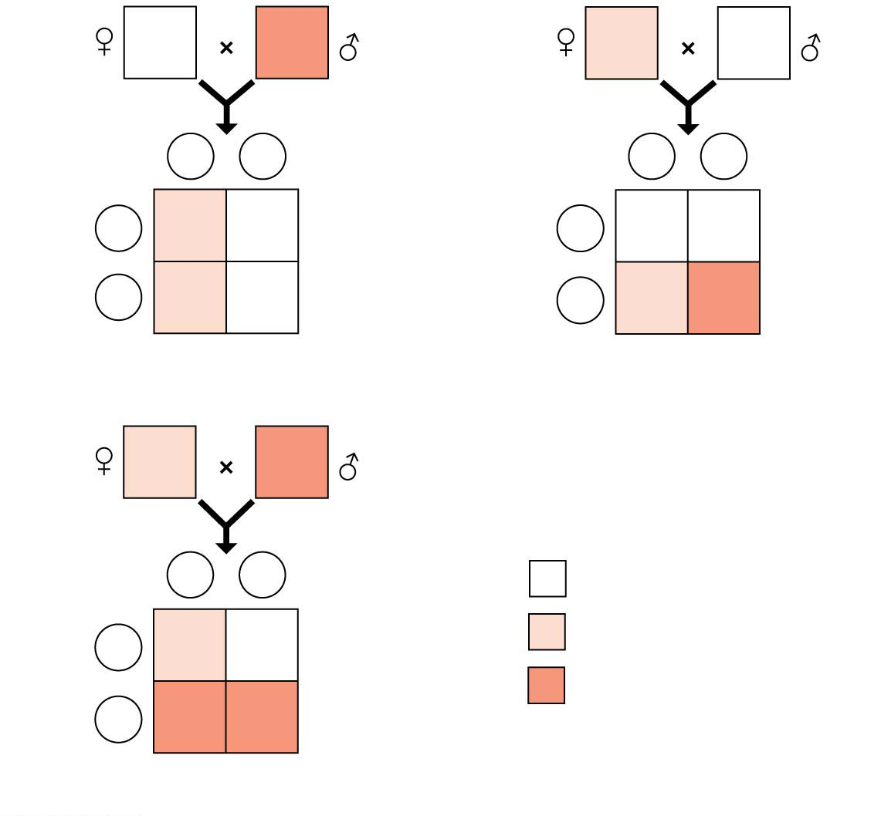
Figure 9.27
X^{N}X^{N}
X^{n}Y
X^{N}X^{n}
X^{N}Y
X^{n}
Y
Sperm
X^{N}
Y
Sperm
Eggs
X^{N}
X^{N}X^{n}
X^{N}Y
Eggs
X^{N}
X^{N}X^{N}
X^{N}Y
X^{N}
X^{N}X^{n}
X^{N}Y
X^{n}
X^{N}X^{n}
X^{n}Y
(a) Normal female × colorblind male
(b) Carrier female × normal male
X^{N}X^{n}
X^{n}Y
Key
X^{n}
Y
Sperm
Unaffected individual
X^{N}
X^{N}X^{n}
X^{N}Y
Carrier
Eggs
Colorblind individual
X^{n}
X^{n}X^{n}
X^{n}Y
(c) Carrier female × colorblind male
Notes:
Figure 9.27 Inheritance of colorblindness, a sex-linked recessive trait

Slide 40
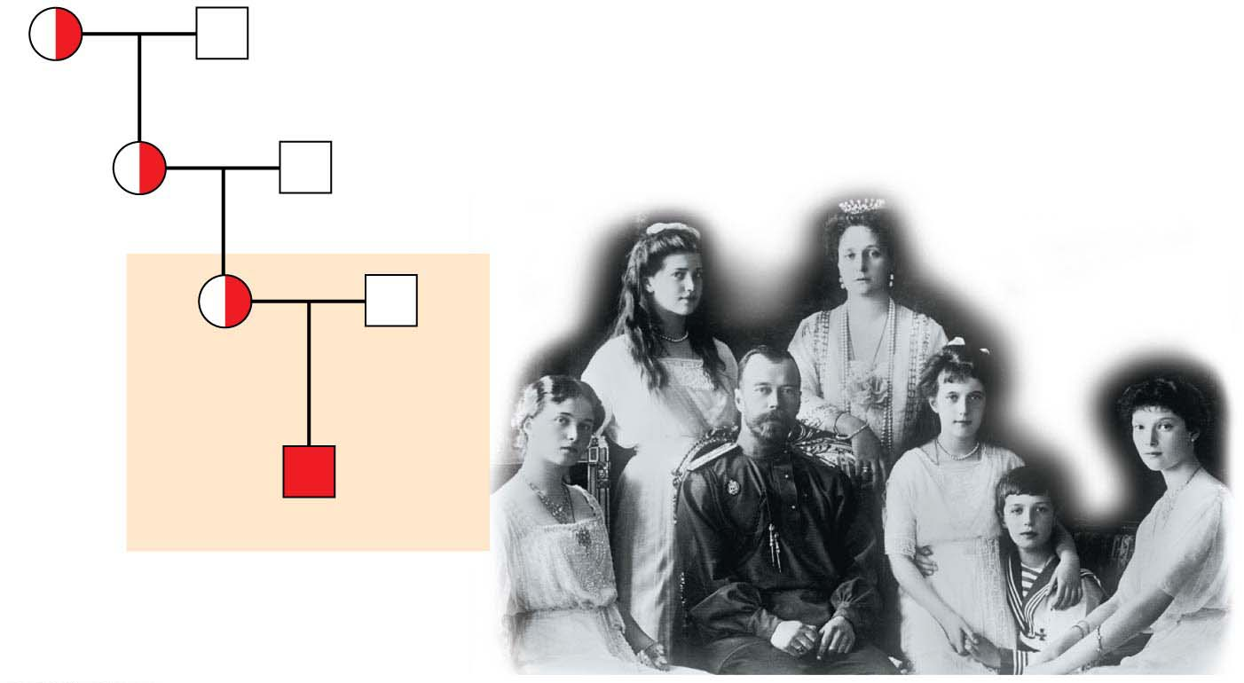
Hemophilia혈우병 is a sex-linked recessive trait with a long, well-documented history.
Hemophiliacs bleed excessively when injured because they have inherited an abnormal allele for a factor involved in blood clotting.
The most seriously affected individuals may bleed to death after relatively minor bruises or cuts.
The age-old practice of strengthening international alliances by marriage effectively spread hemophilia through the royal families of several nations.
Queen
Victoria
Albert
Alice
Louis
Czar
Nicholas II
of Russia
Alexandra
Alexis
Notes:
40
Student Misconceptions and Concerns
1. This section of the chapter relies on a good understanding of the chromosome sorting process of meiosis. If students were not assigned Chapter 8, and meiosis was not otherwise addressed, it will be difficult for students to understand the chromosomal basis of inheritance or linked genes.
2. The nature of linked genes builds on our natural expectations that items that are closer together are less likely to be separated. Yet students may find such concepts initially foreign. Whether it is parents holding the hands of children or people and their pets, we generally know that separation is more likely when things are farther apart. You might demonstrate this simply by drawing a line down a page of text. The likelihood that the line separates any pair of words increases, as the distance between the words grows farther apart.
3. The discussion of “linked genes” addresses a different relationship than the use of the similar termed “sex-linked genes.” The nature of the linkage is quite different. Consider emphasizing this distinction for your students.
4. The likelihood that at least some students are colorblind in larger classes is very high. Some of these students might find this interesting and want to discuss it further. However, others might be embarrassed by what might be perceived as a defect.
Teaching Tips
1. Building on the shoe analogy developed in Chapter 8, linked genes are like a shoe and its shoelaces. The two are usually transferred together but can be moved separately under special circumstances.
2. Crossing over (from Chapter 8) is like randomly editing out a minute of film from two movies and swapping them. Perhaps the fifth minute of Bambi is swapped for the fifth minute of a Shrek film. Clearly, the closer that two frames of film are together, the more likely they are to move or remain together.
3. In some ways, sex-linked genes reflect the risk of not having a backup copy of a file on your computer. If you only have one copy and it is damaged, you have to live with the damaged file. Having two X chromosomes in females provides a “backup copy” that can function if one of the sex-linked genes is damaged.
4. Hemophilia and other genetic diseases may also result from spontaneous mutations in a family with no known history of the disease. Although rare, this possibility should always be considered when tracing the history of an inherited disease.
5. Female hemophiliacs are very rare because both X chromosomes would need to have the recessive trait. Although very unlikely, female hemophiliacs are known. Students may enjoy searching for details of these rare cases. For additional information about hemophilia, consider visiting the website of the National Hemophilia Foundation at www.hemophilia.org.
Active Lecture Tips
1. See the activity Pairs of Shoes and Pairs of Chromosomes on the Instructor Exchange. Visit the Instructor Exchange in the MasteringBiology instructor resource area for a description of this activity.
2. See the Media Review: “Learn.Genetics” Genetic Science Learning Center from the University of Utah on the Instructor Exchange. Visit the Instructor Exchange in the MasteringBiology instructor resource area for a description of this activity.

